Slide 1
How to begin and start an exercise program for a beginner
A.k.a.: don’t be a weekend warrior

Slide 2

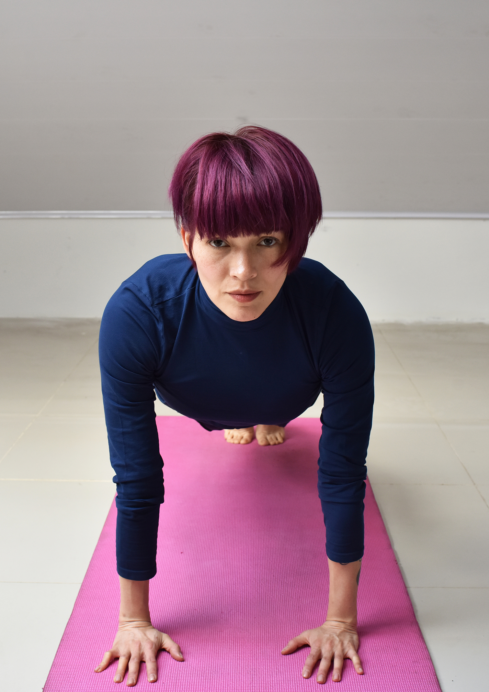
Step one
Starting a fitness program maybe one of the best things you can do for your health and may be one of the most challenging things to start.
Insecurities such as shyness and self-esteem play a role as a barrier to beginning a fitness journey.
Always remember that a fitness program is a selfish and a personal goal.
And if you’re uncomfortable alone try and get a partner to share the journey.

Slide 3

Step two: determine your fitness level
Consider getting a physical exam and release from your physician.
Know your physical abilities and limitations including general muscle strength and joint strength and mobility.
Ask for assistance or work with a personal trainer experienced in your needs and abilities.
And begin with a program or exercises that you’re comfortable and confident with.

Slide 4
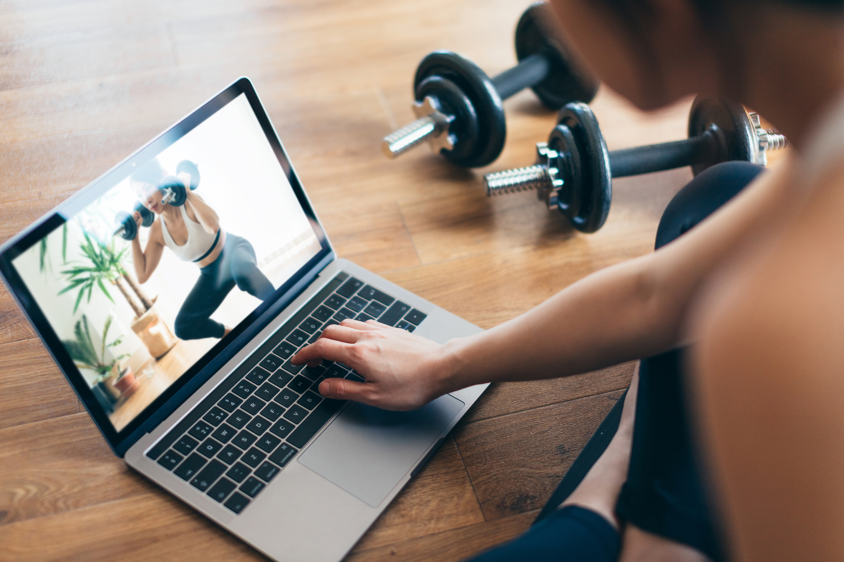
Step three: keep a journal
Keep a journal or a record of the exercises you do including duration, amount of weight, any challenges you faced.
The key is to start slow, don’t be a weekend warrior and burn yourself out in the first week.
Understand it’s a building journey, we didn’t get out of shape overnight and we won’t get into shape from one workout.
Make a plan and stick to the plan and allow for the ups and the downs.

Slide 5
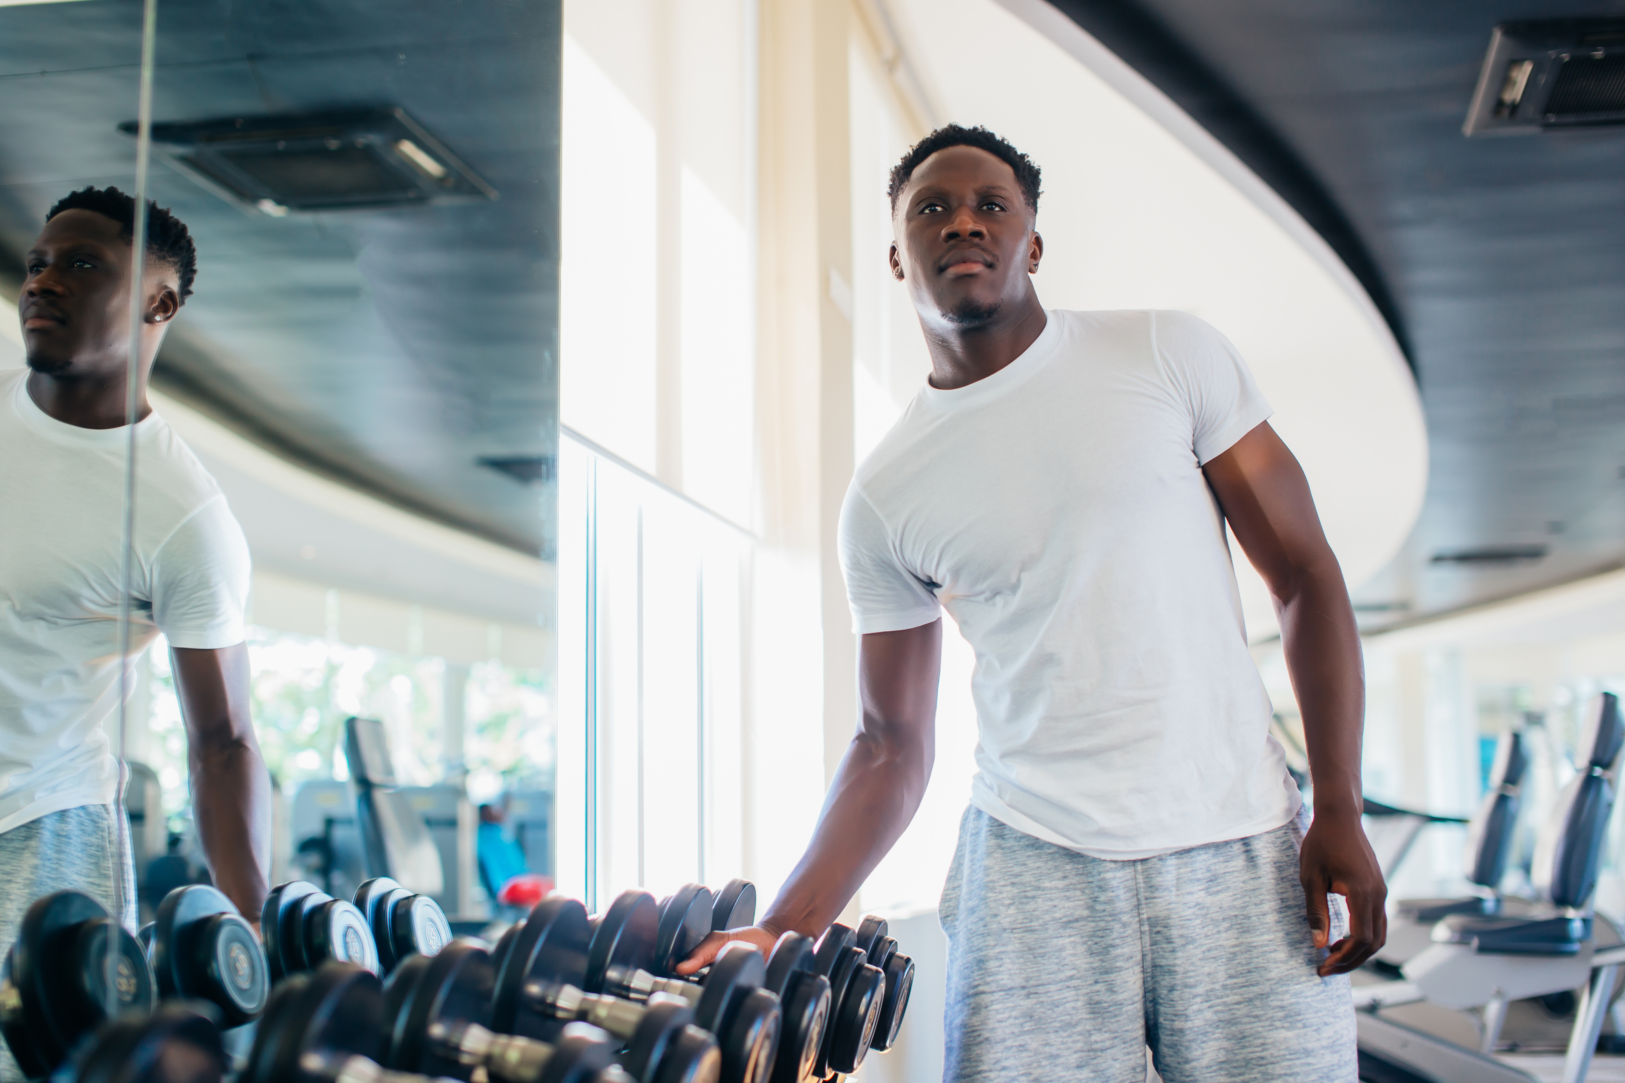
Step four: using appropriate equipment
Be familiar with both free weight and machine exercises.
Do not be afraid of using just body weight exercises such as squats and push-ups to begin.
Don’t put a timeframe on your exercise periods or programs, anywhere from 10 minutes to 30 minutes to begin depending on your level of experience and fitness.

Slide 6
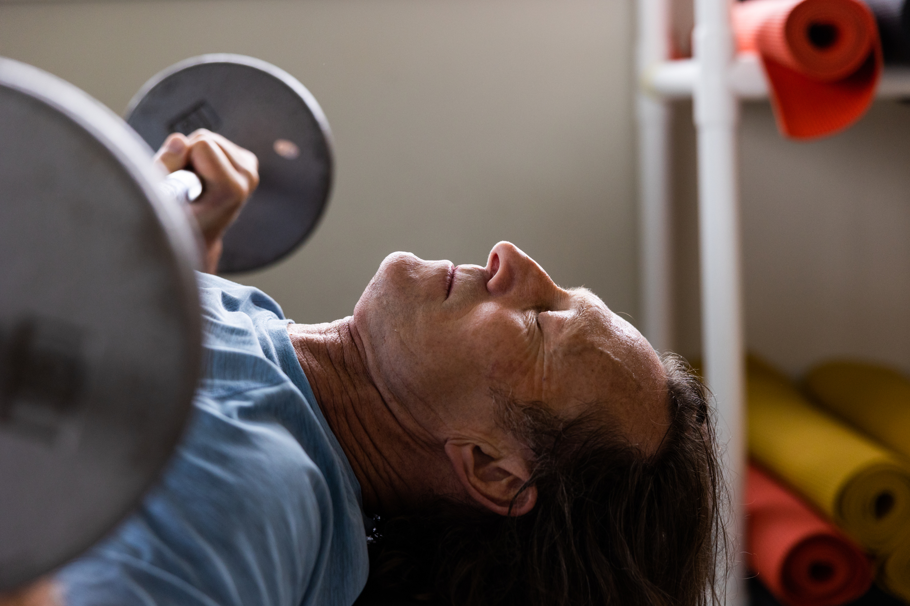
Step five: progress
Continue to measure your progress based on how you feel, where are you improved, and changes you see, feel and record from your journal.
Listen to your body. To be times when you can do more and times when you need more rest. It’s OK to take breaks. It’s OK to push yourself a little bit as you feel stronger.
Do you feel yourself getting stronger consider a workout partner if you’re doing weight resistance that needs a partner i.e. spotter. Do you know when that time comes.

Slide 7
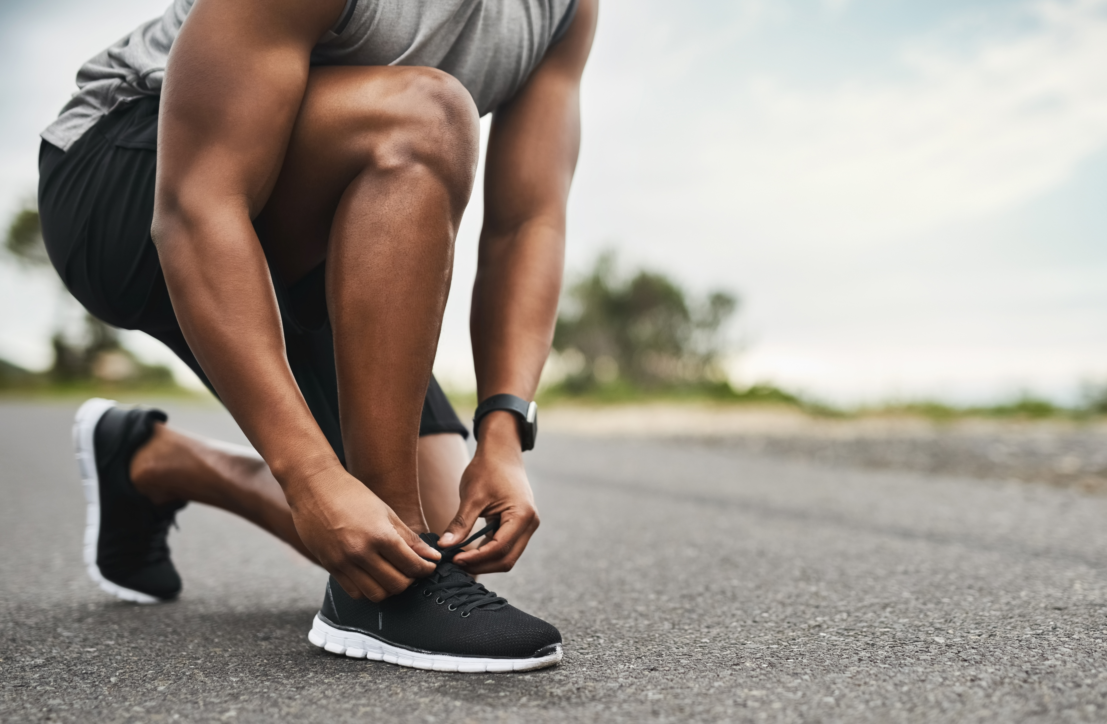
It’s a lifestyle and it’s a lifetime journey to stay healthy and fit.
Don’t worry about body measurement or aesthetics you’re working on making personal changes. You know that you’re improving by the way your clothes for you. And remember, you’ll notice the first couple of weeks, your friends will notice after about a month, and the rest of the world notice as you continue to improve your fitness.
I don’t compare yourself to other people you’re on your own personal journey. Don’t worry about sacrificing the time each day or during the week or month that you spend on just yourself. You’re not being selfish toward your family you’re being selfish towards you for a change.

