Slide 1
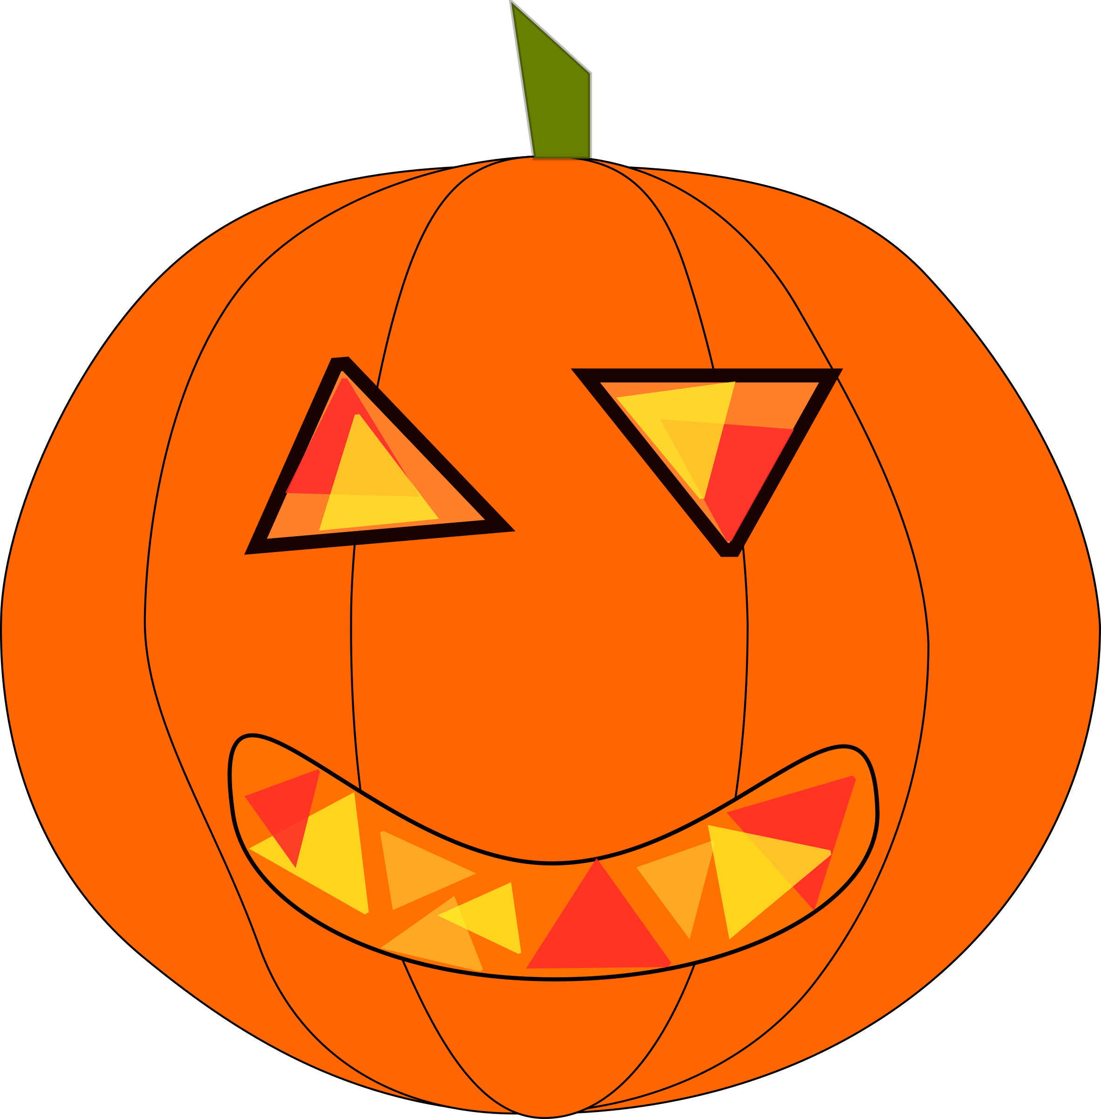

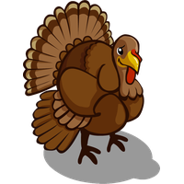
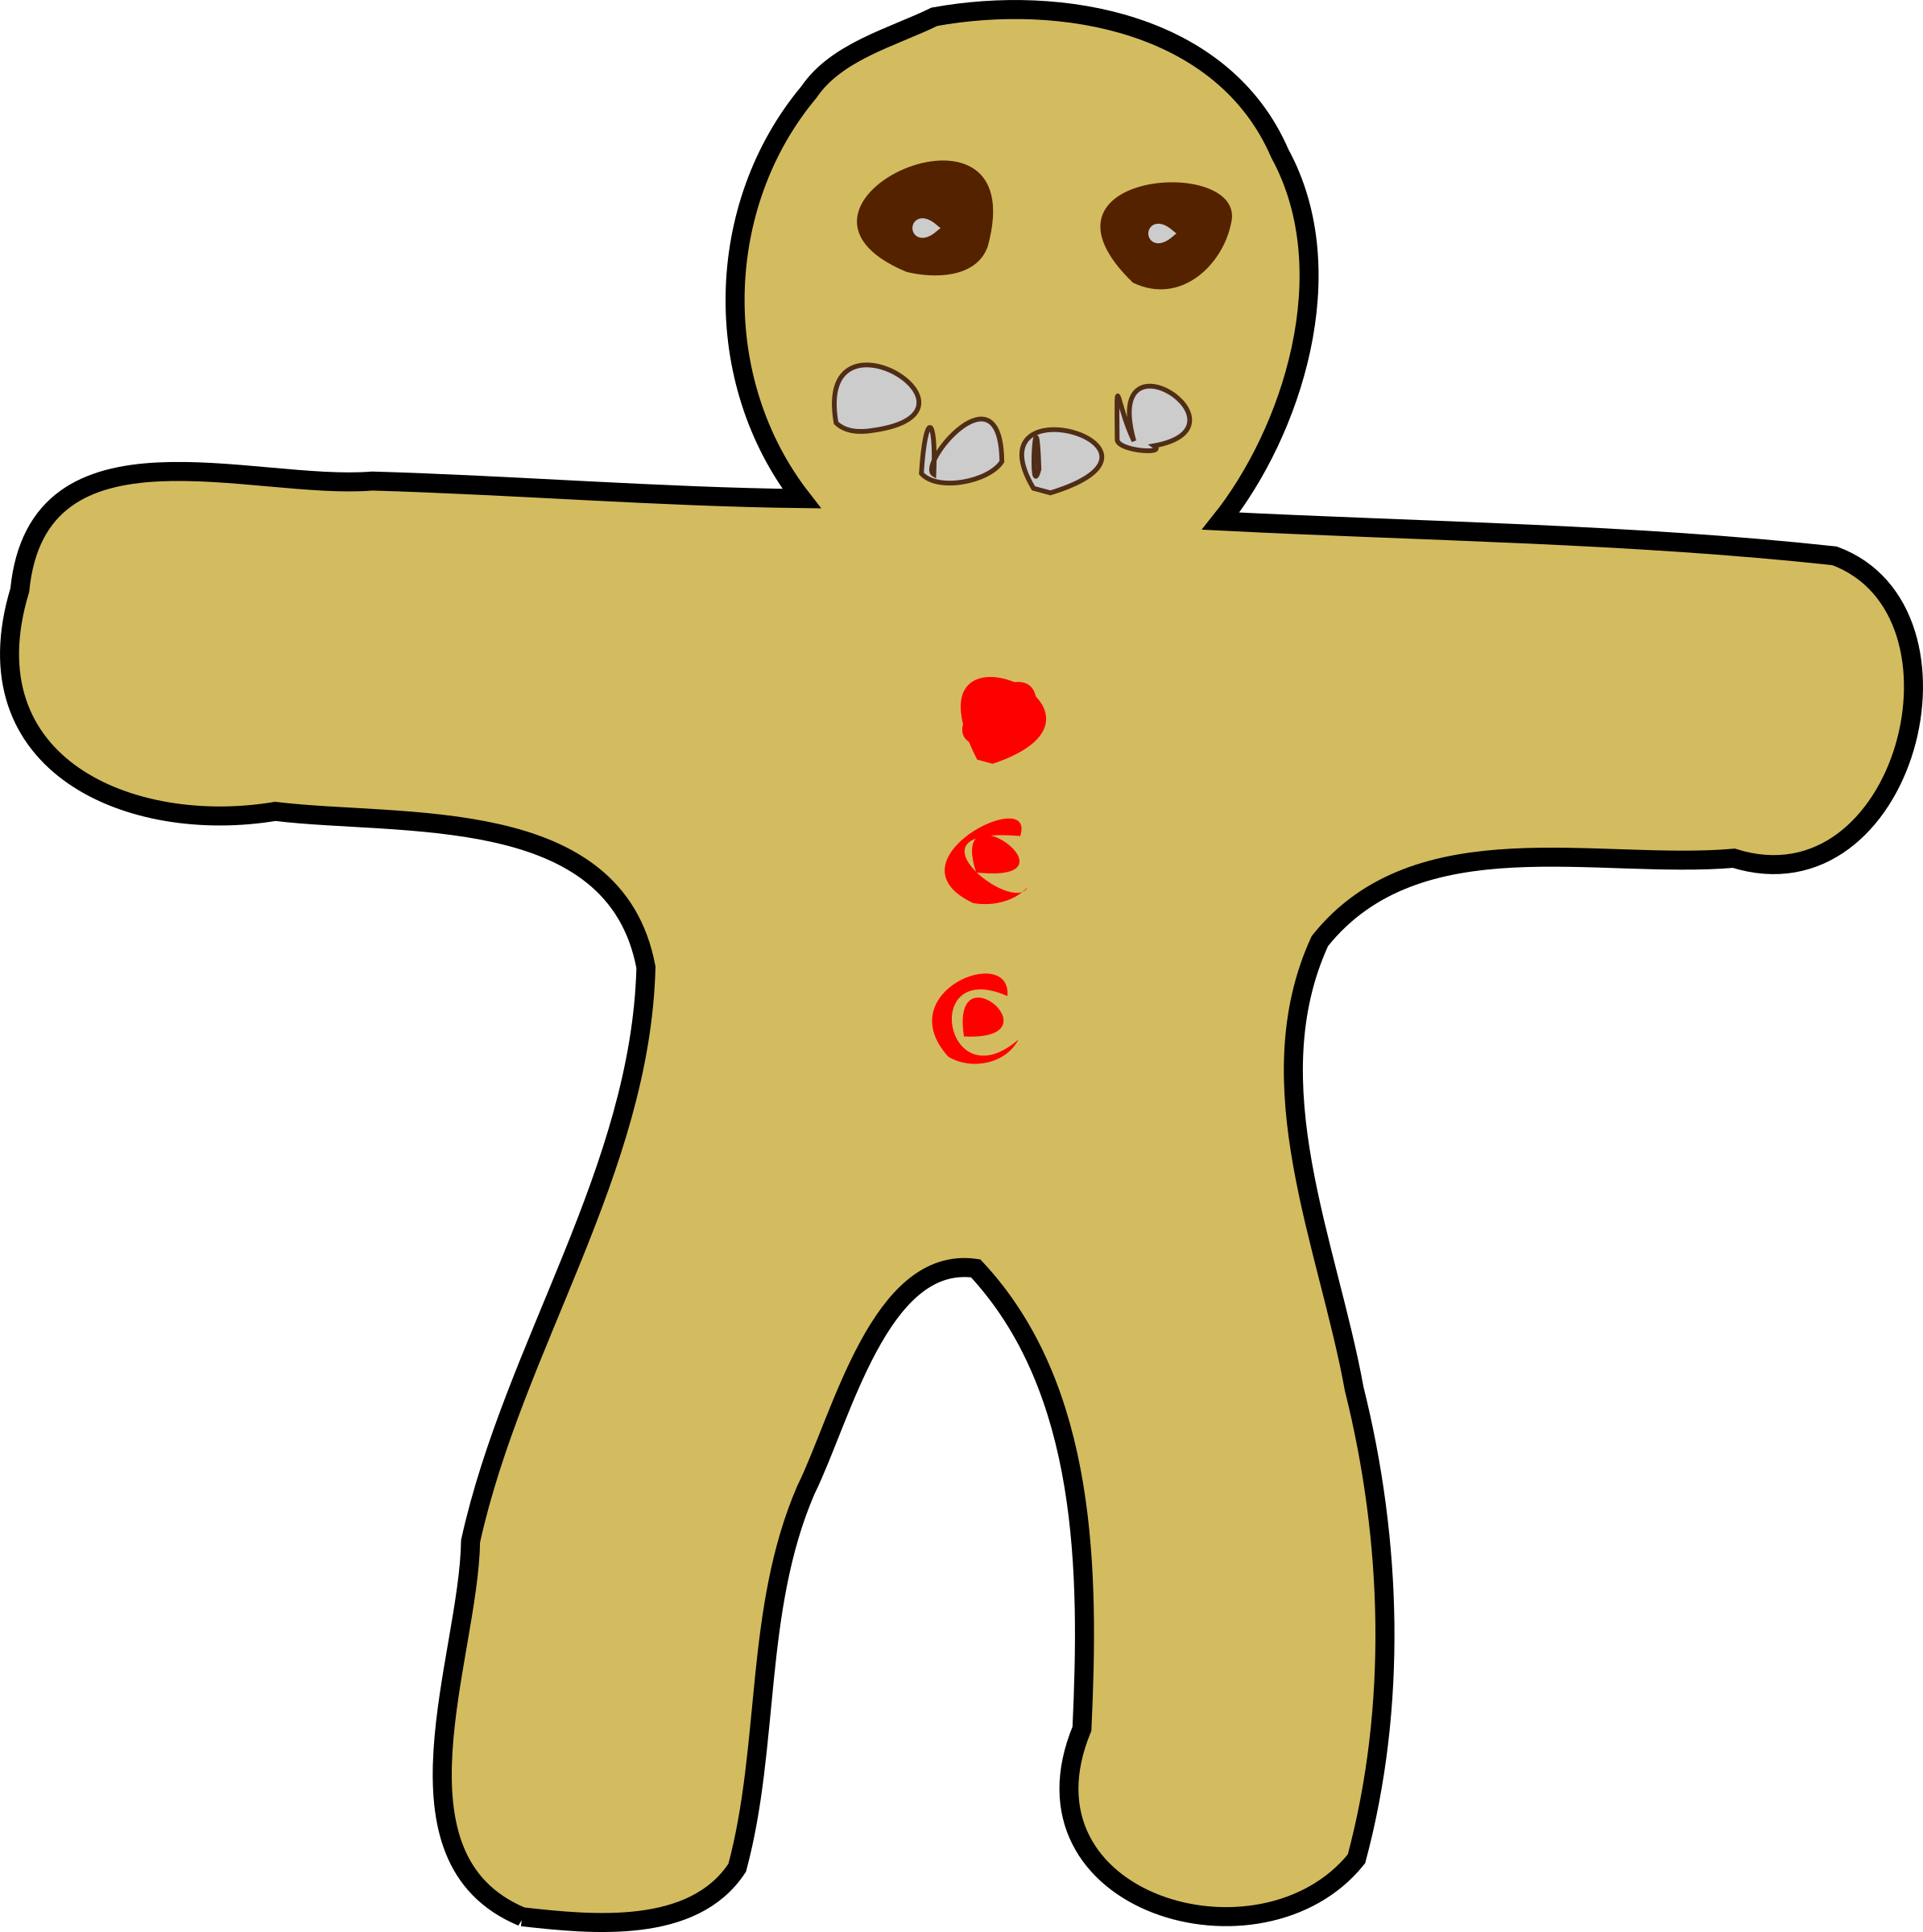
Holiday fun & Fitness:
Elementary PE games for every season!

Slide 2

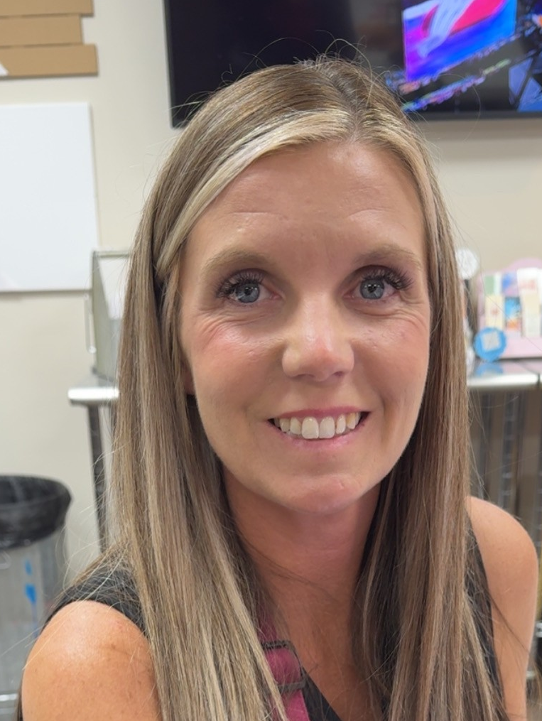
Meet your presenters: Sunshine Gay & Stephanie Young
Sunshine Gay has been teaching for 16 years. She has been the physical education teacher at Pearl Watson Elementary for 11 years.
Stephanie Young has been teaching for 18 years. She has been the curriculum coordinator at Pearl Watson Elementary for 4 years.
sunshine.gay@cpsb.org
stephanie.young@cpsb.org

Slide 3
Agenda
Intro
Zombie Tag
Witches Hat Tag
Stuff the Turkey
Geaux for the Gold
Stations (3 Halloween, 2 Winter, 3 Easter)
Closing & Door Prizes

Slide 4


Zombie Tag
The game starts with one zombie (tagger).
The zombie must keep one foot in a hula hoop dragging it on the ground while chasing the humans.
When a human is tagged, they are now a zombie too and must get a hula hoop.
As a zombie, they join the other zombie in tagging humans.
The game continues until there is only one human left.
The last human starts the next game as the new tagger aka zombie.

Slide 5

Witches Hat Tag
The game starts with one witch (tagger).
The witch must hold a cone on their head like a witch’s hat while chasing the goblins.
When a goblin is tagged, they are now a witch too and must get a cone.
As a witch, they join the other witches in tagging goblins.
The game continues until there is only one goblin left.
The last goblin starts the next game as the new tagger aka witch.

Slide 6
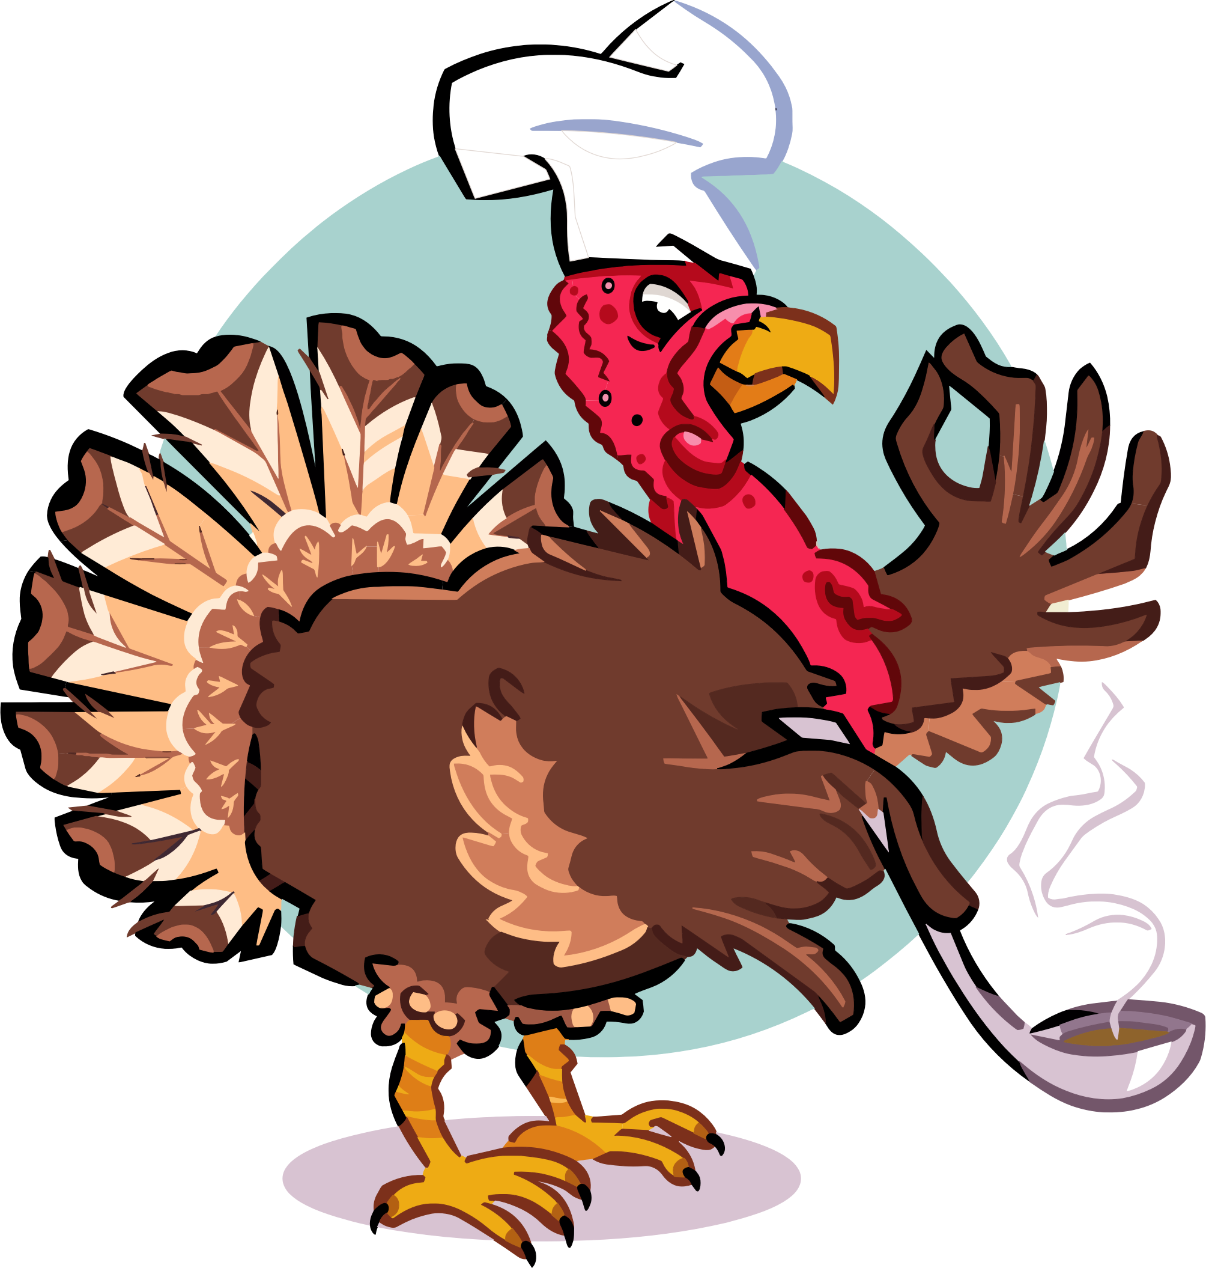
Stuff the Turkey
Set-up:
Place four different colored hula hoops (Nest) in the corner of the activity area.
Dump bean bags into the center of play area.
Divide the class into 4 different teams.
Choose 2-3 students to wear Red Pinnies – Hunters.
Choose 2 students to wear the yellow pinnies – Farmers. Hunters and farmers start in the center of the gym.
The rest of the students are the Turkeys. Turkeys start in the corner with their basket (Nest).
Game Play:
On the go signal, the Turkeys from each team move to the center (vary locomotive skills) to steal food and tries to bring it back to their turkey nest.
Turkeys are allowed to get only 1 piece of "food".
When turkeys are trying to steal food, the hunters can gently tag a turkey.
If the turkey is tagged, they freeze like a scarecrow with arms straight out and legs separated.
Farmers see their scared turkeys and come to the rescue.
Farmers crawl through the legs of the scarecrow/turkey from the front of the scarecrow.
Once the farmer is through, the turkey can move back to their team.
Play continues for a few minutes or until all the food is gathered.

Slide 7

Geaux for the Gold
Students need to cross the rainbow to get gold from the leprechaun’s pot.
Three students with green jerseys will represent the leprechauns trying to prevent students from stealing their gold.
The pot will be the be in the middle of the play area.
Beanbags and/or a ball assortment will represent the gold.
Partners will have their scooters connected and must work together to get to the other side of the rainbow.
They can only get one piece of gold each to bring back to their baskets which are located at the beginning of the rainbow.
If tagged by a leprechaun, they must put the gold currently in their hand back in the pot and start back at the beginning of the rainbow.
When the pot of gold is empty, partners will return to their baskets and count their gold. The set of partners with the most gold wins.
Change out leprechauns each new game.

Slide 8



STATIONS
Halloween Stations
Booling
Hurdle the Headstones
Witches Hat Ring Toss
Winter Stations
Ice Skating
Snowball Fight
Easter Stations
Exercise Eggs
Hopping the Trail
Tossing Eggs in a Basket

Slide 9


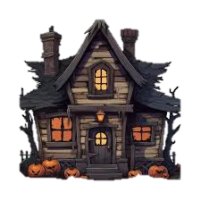

Thanks for joining the fun!
Happy Holidays & Happy Haunting!

Slide 10
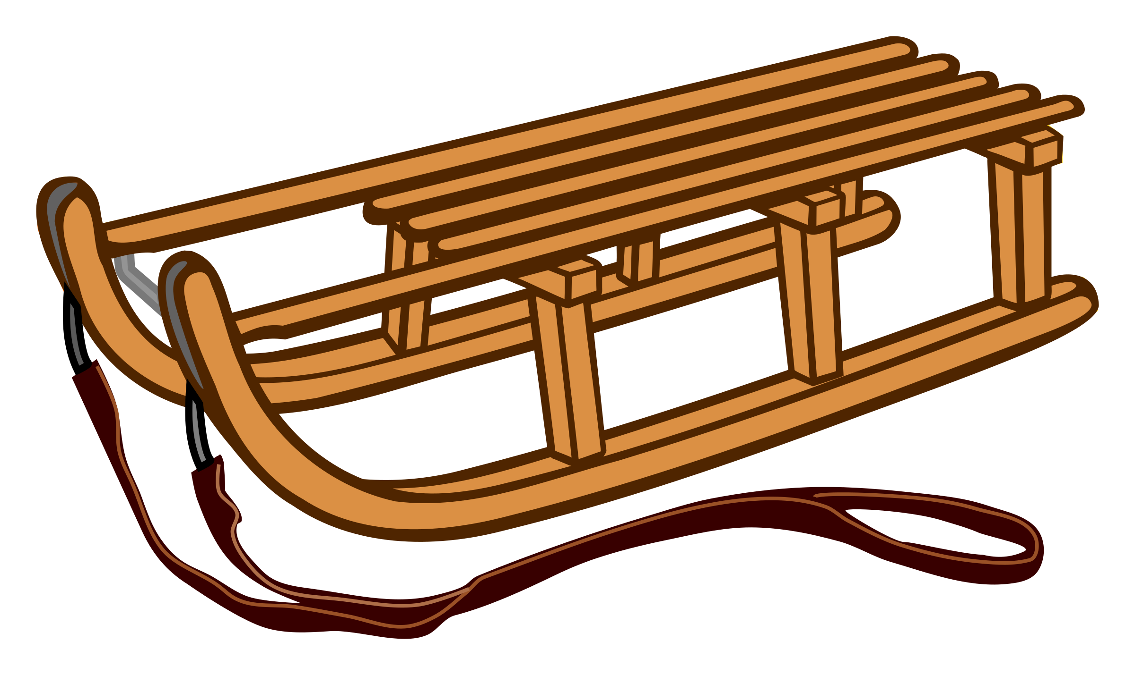
Winter Stations: Holiday Fun in Motion!
Students rotate through 8 holiday-themed stations while festive music plays. Each group has 4 students.

Slide 11

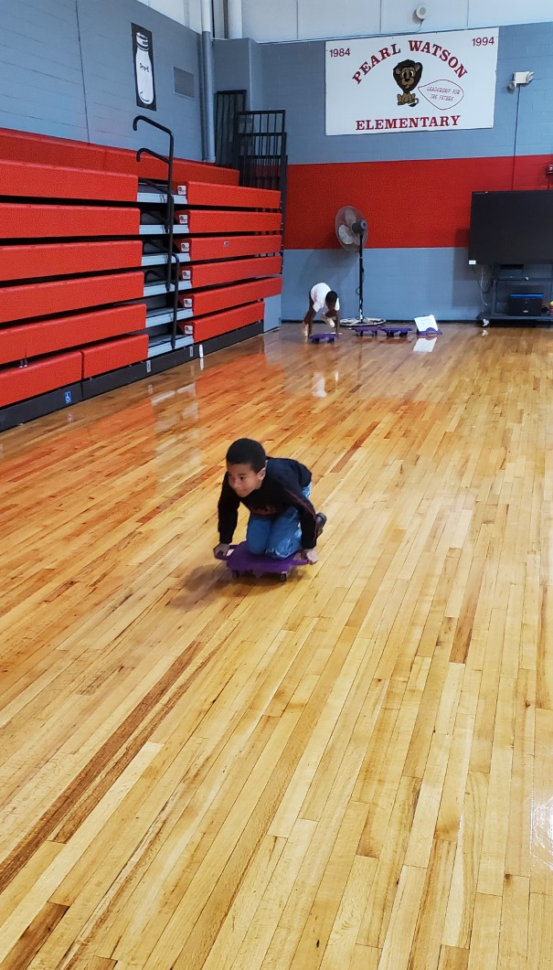
Sledding
Instructions: Sit on scooter board, use feet to move between cones, carry board back uphill.
This Photo by Unknown Author is licensed under CC BY-NC

Slide 12

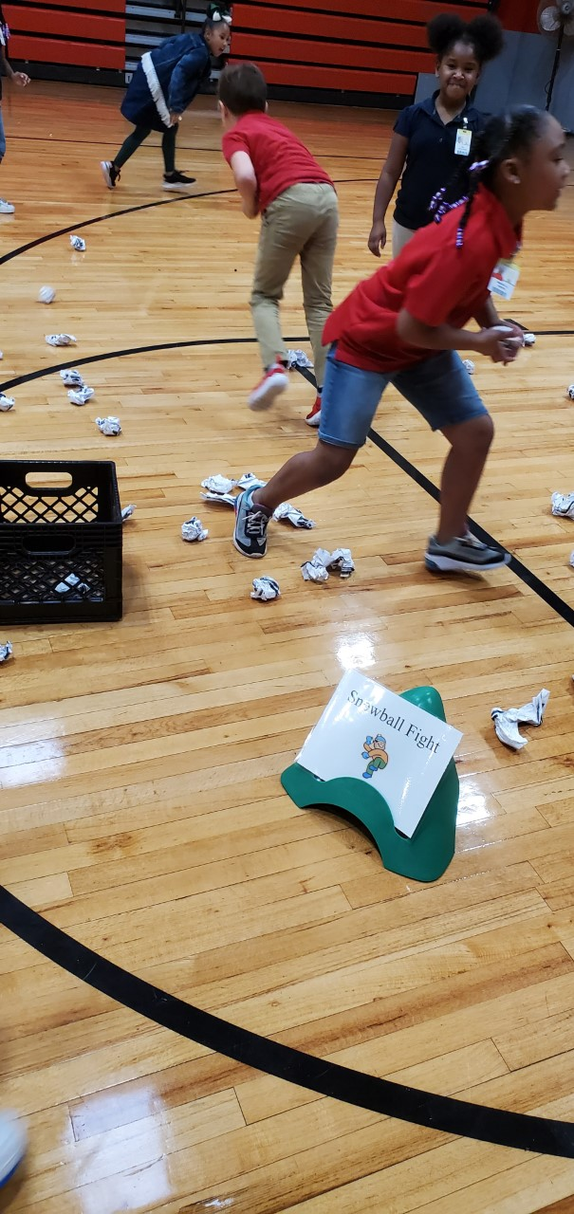
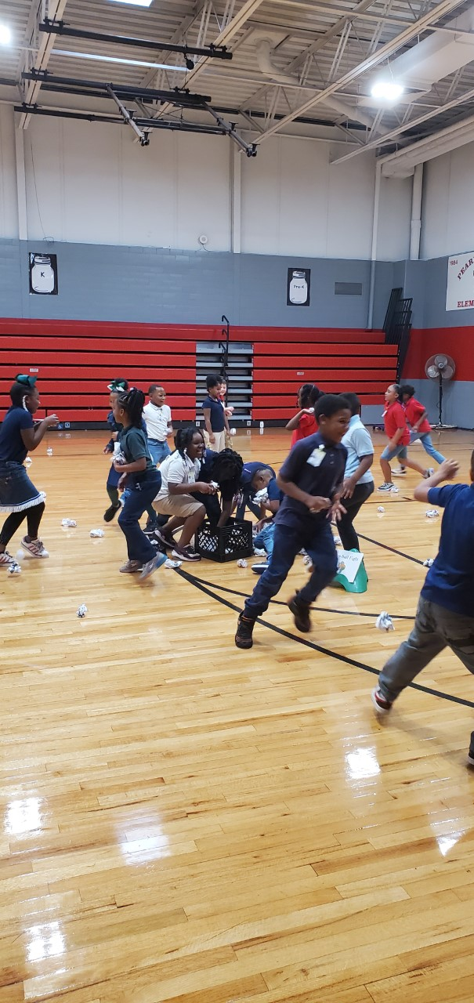

Snowball fight
Instructions: Toss wadded white paper with a partner like snowballs.

Slide 13
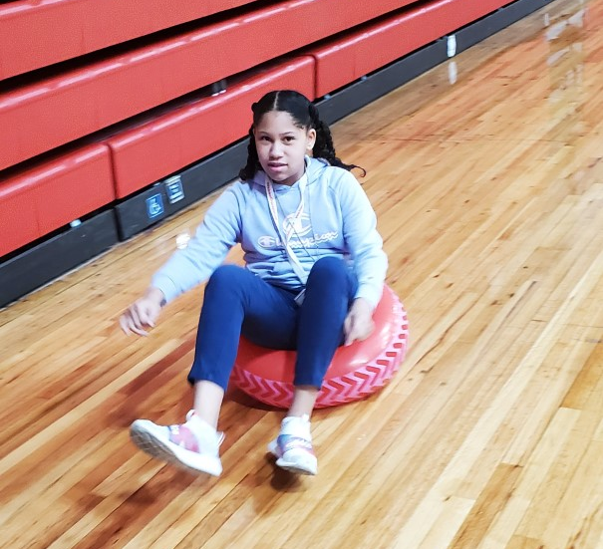
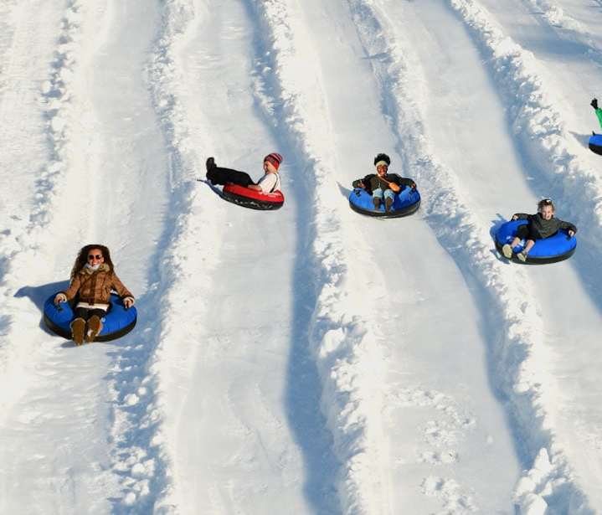
Tubing
Instructions: Sit on scooter with inflatable tube, scoot between cones.

Slide 14
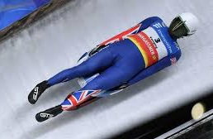
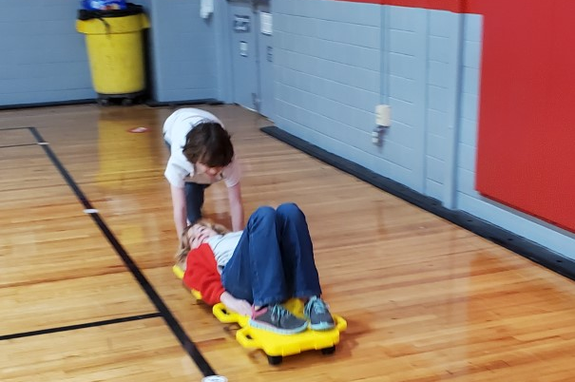
Luge
Instructions: Lay on connected scooters, partner pushes to cone, switch roles.

Slide 15
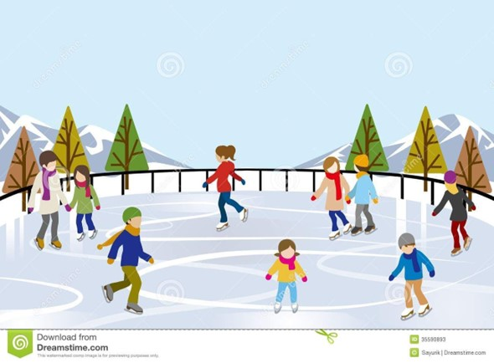
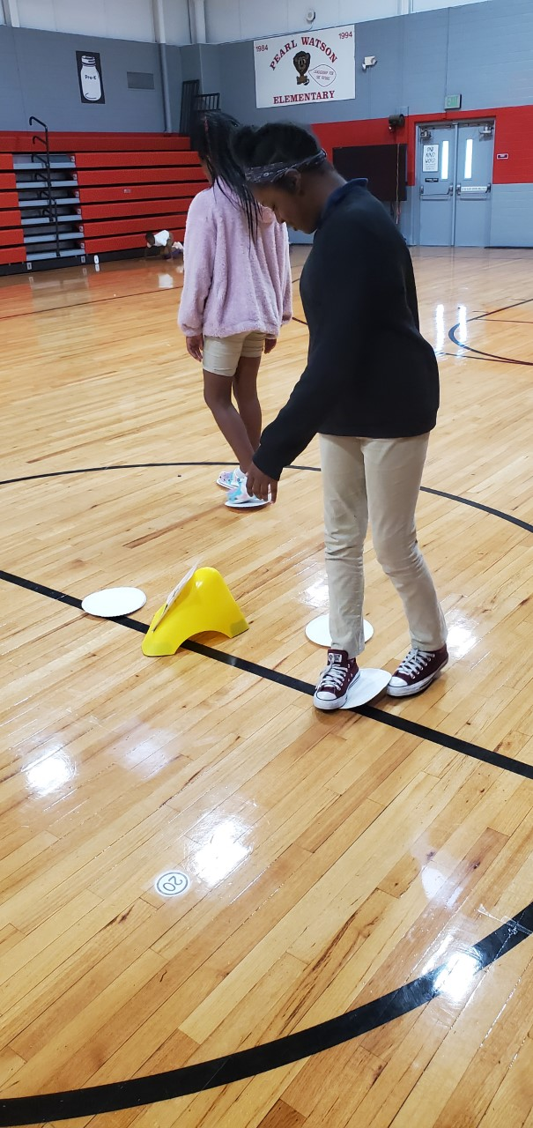

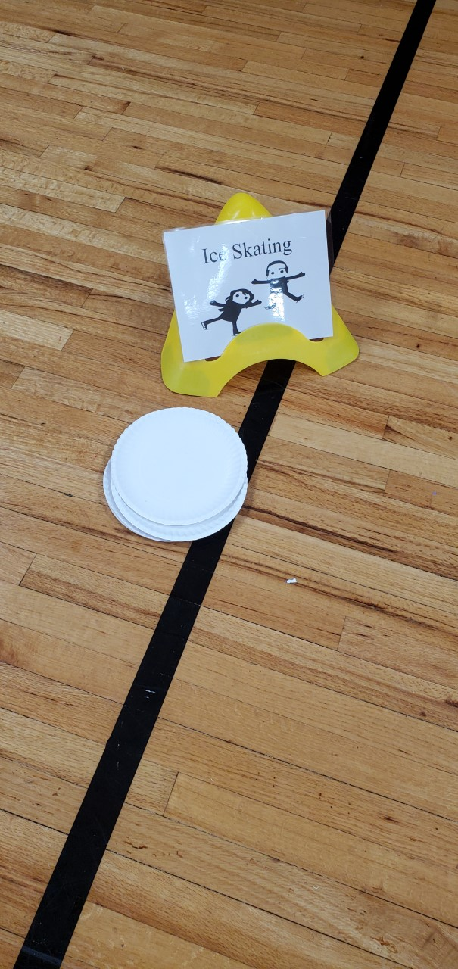
Ice Skating
Instructions: Use paper plates under feet to “skate” on pretend pond.

Slide 16
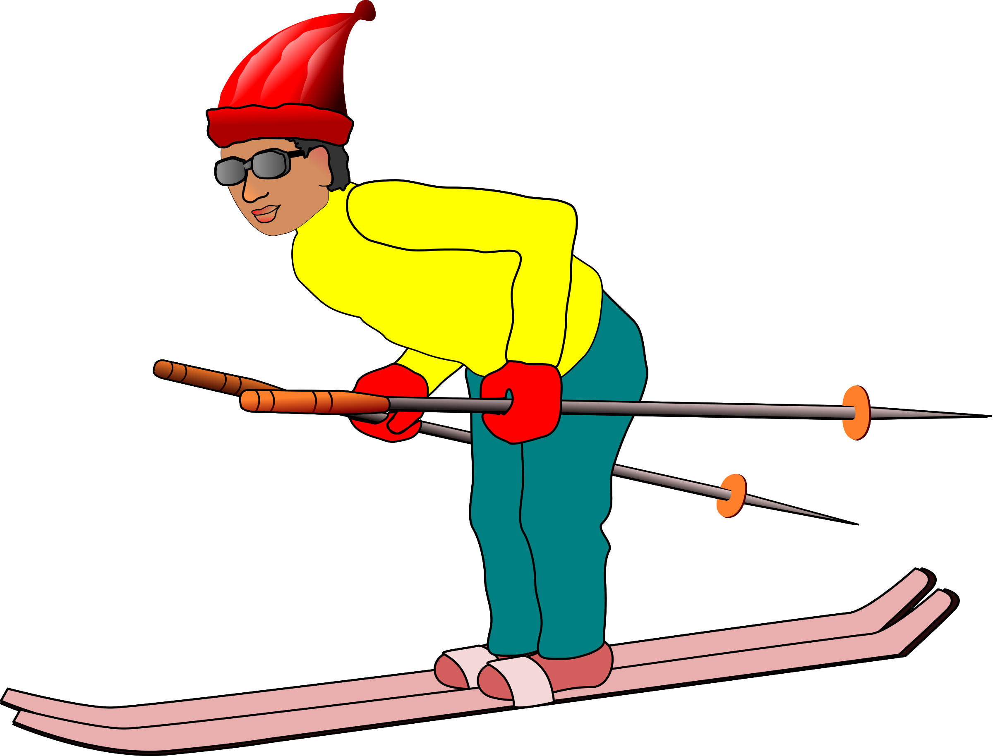
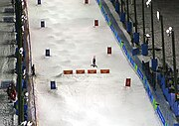
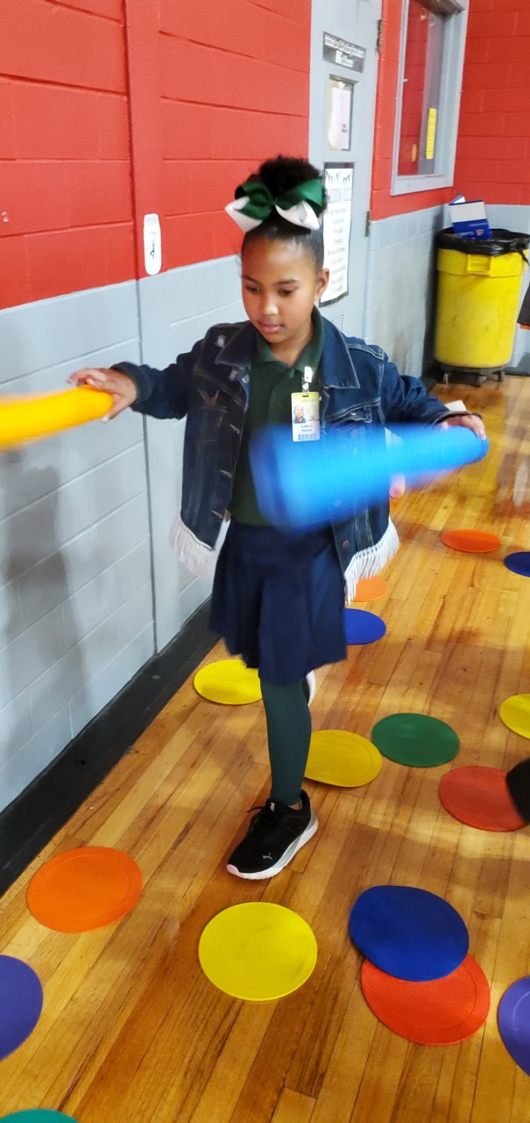
Mogul Skiing
Instructions: Jump from poly spot to spot using pool noodle poles.

Slide 17
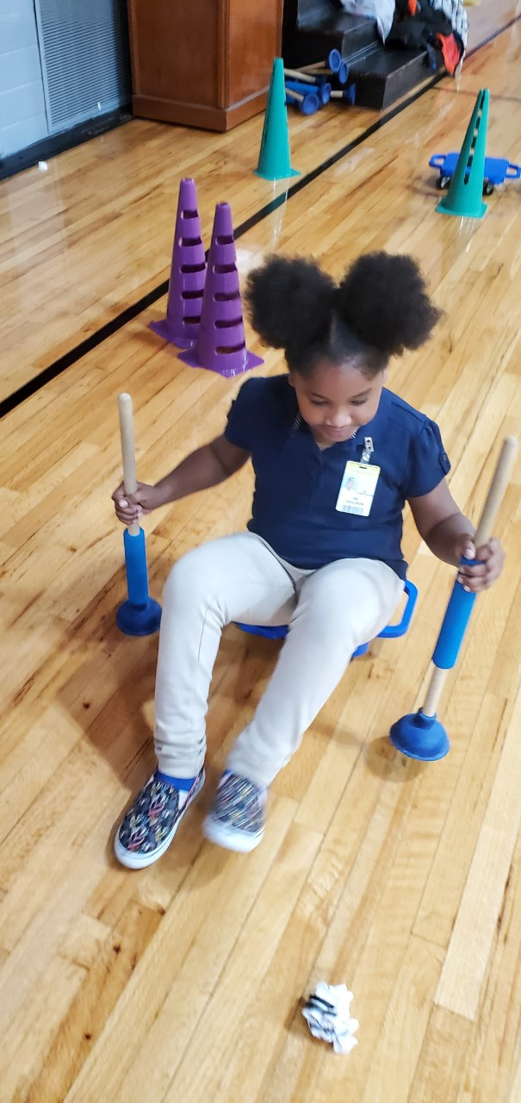


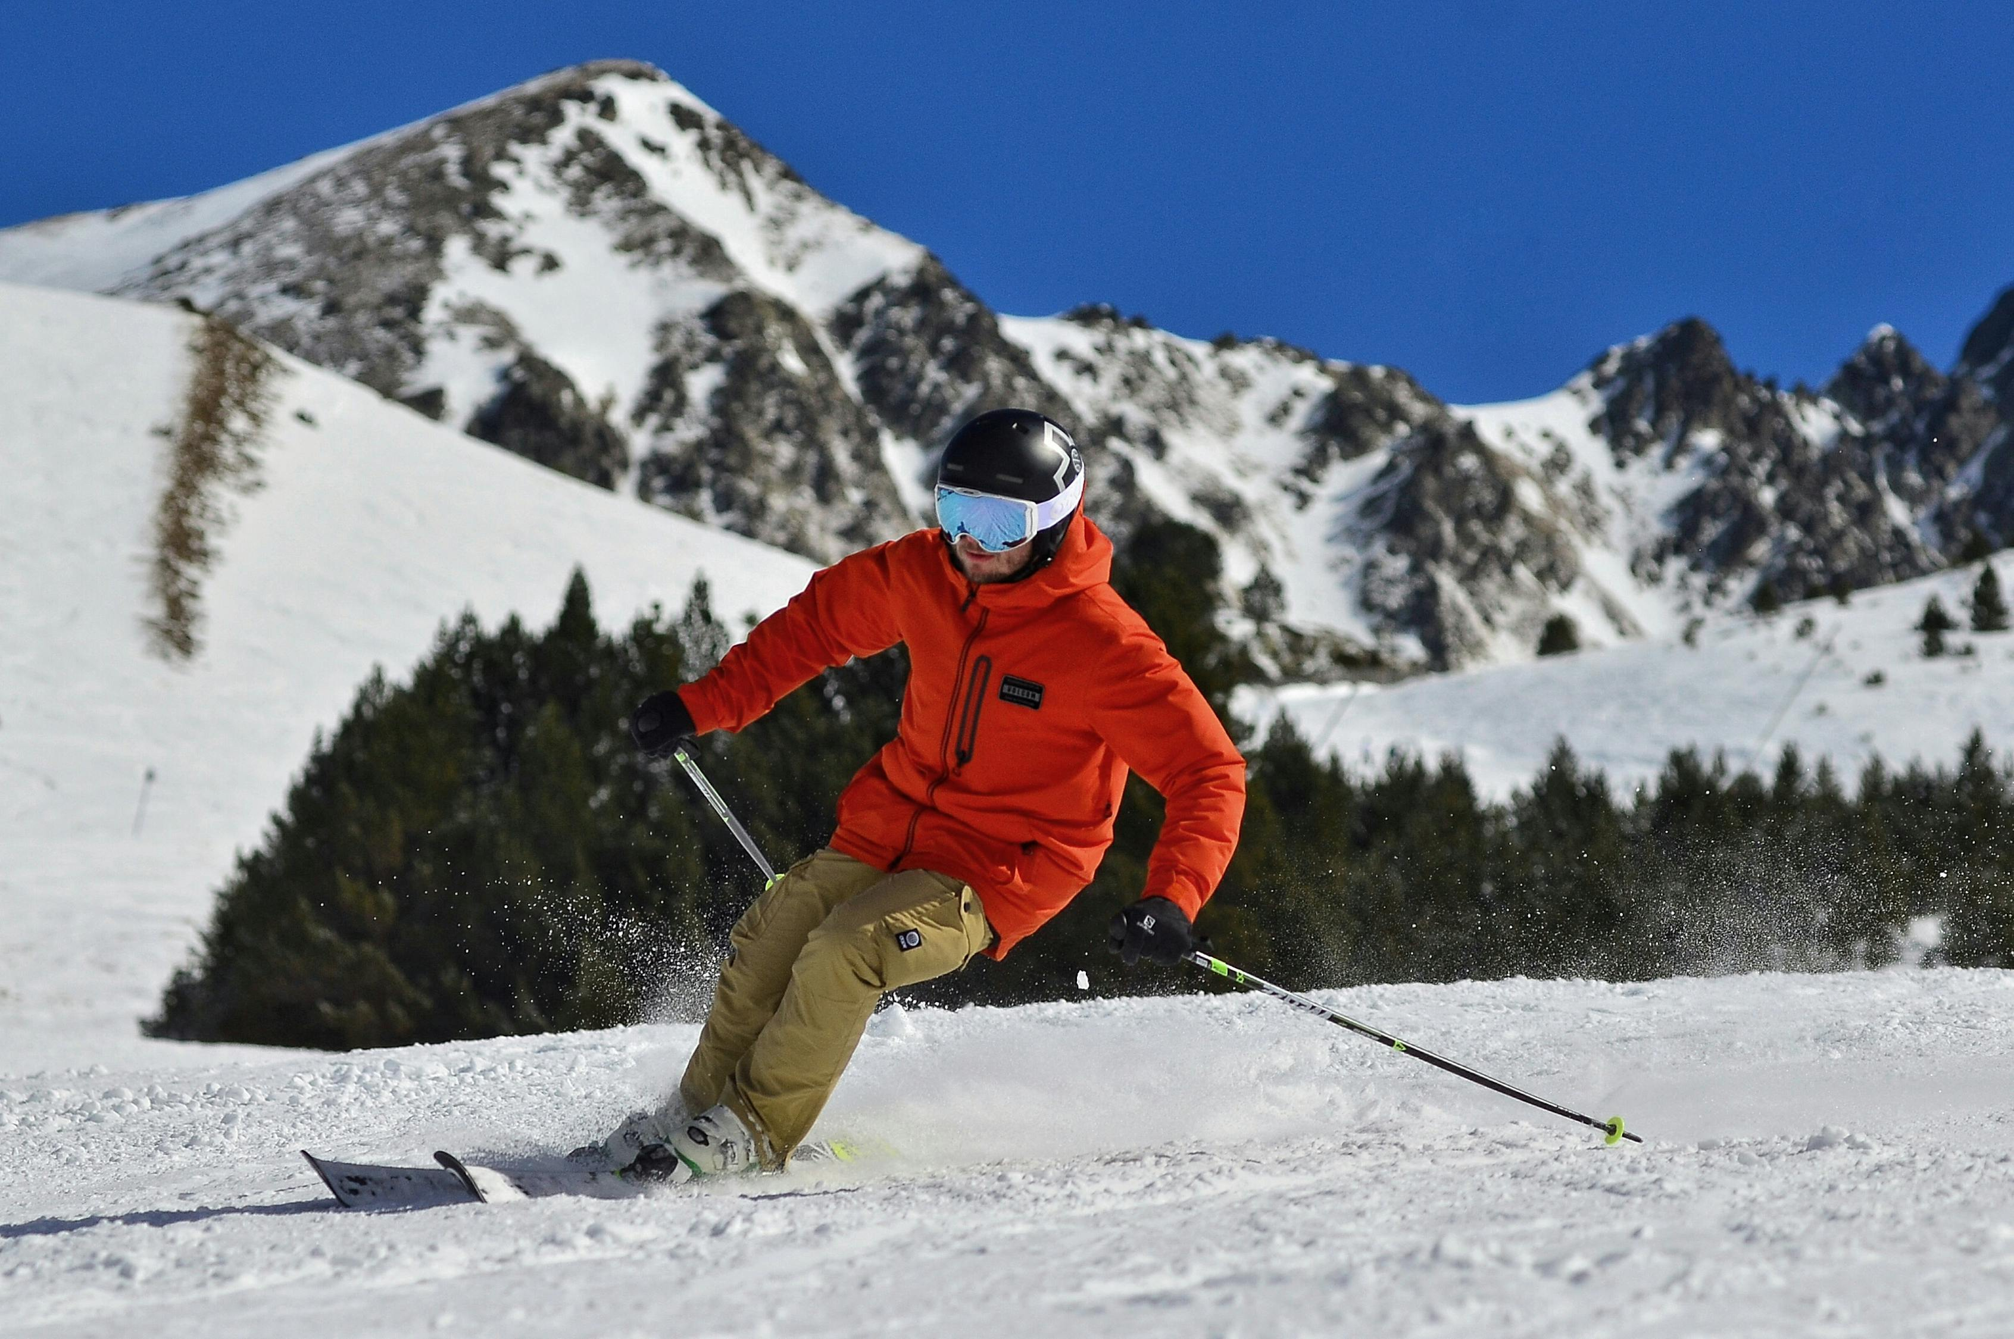
Downhill Skiing
Instructions: Sit on scooter, use plungers to ski through cones, carry board back.

Slide 18
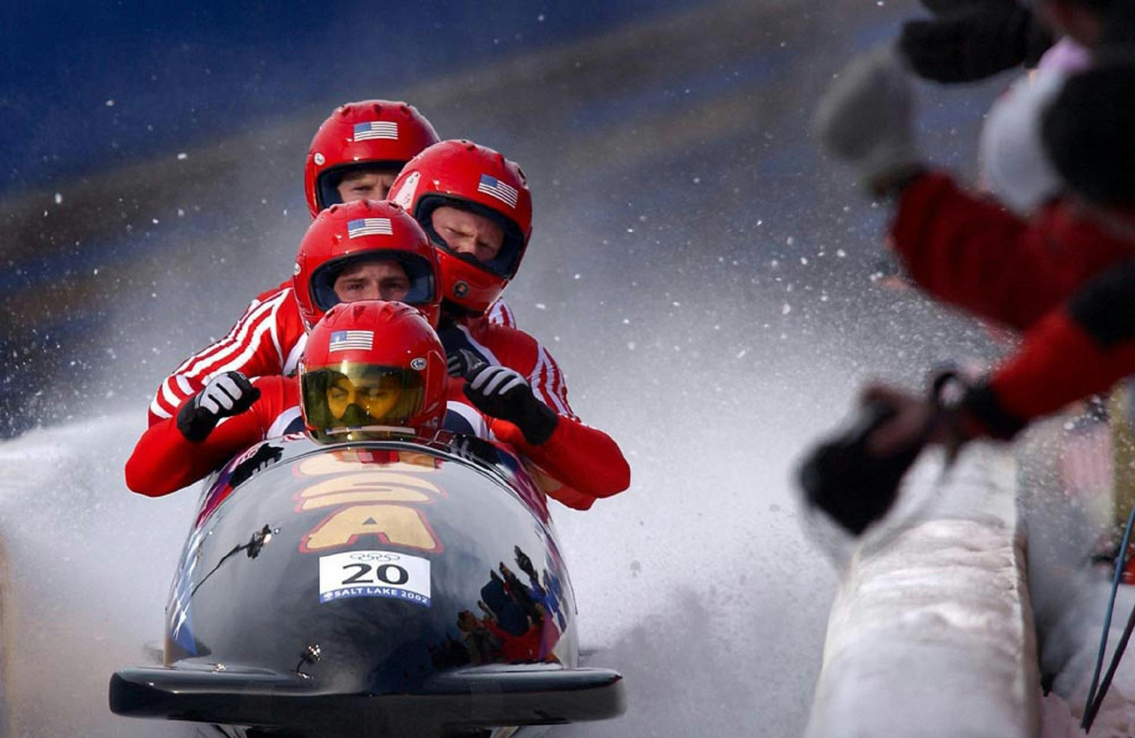
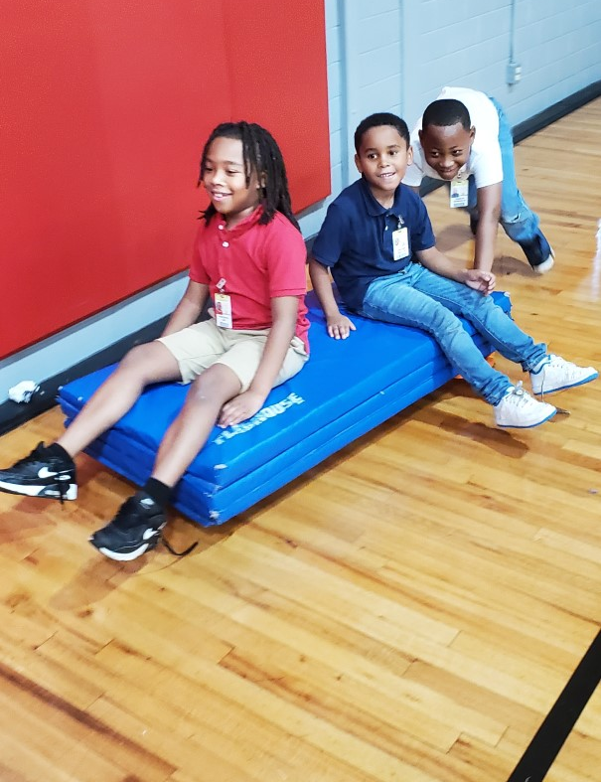
Bobsledding
Instructions: Ride on connected scooters with mat, push from cone to cone.

Slide 19

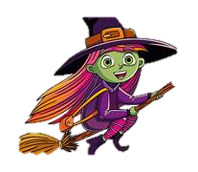
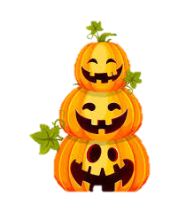
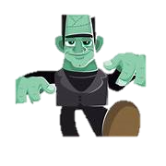
Halloween Stations: Spooky Fun & Games!

Slide 20
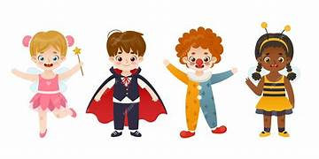
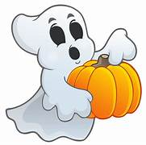
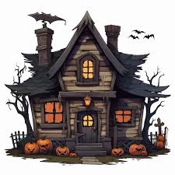
Students rotate through 7 Halloween-themed stations with spooky music.

Slide 21
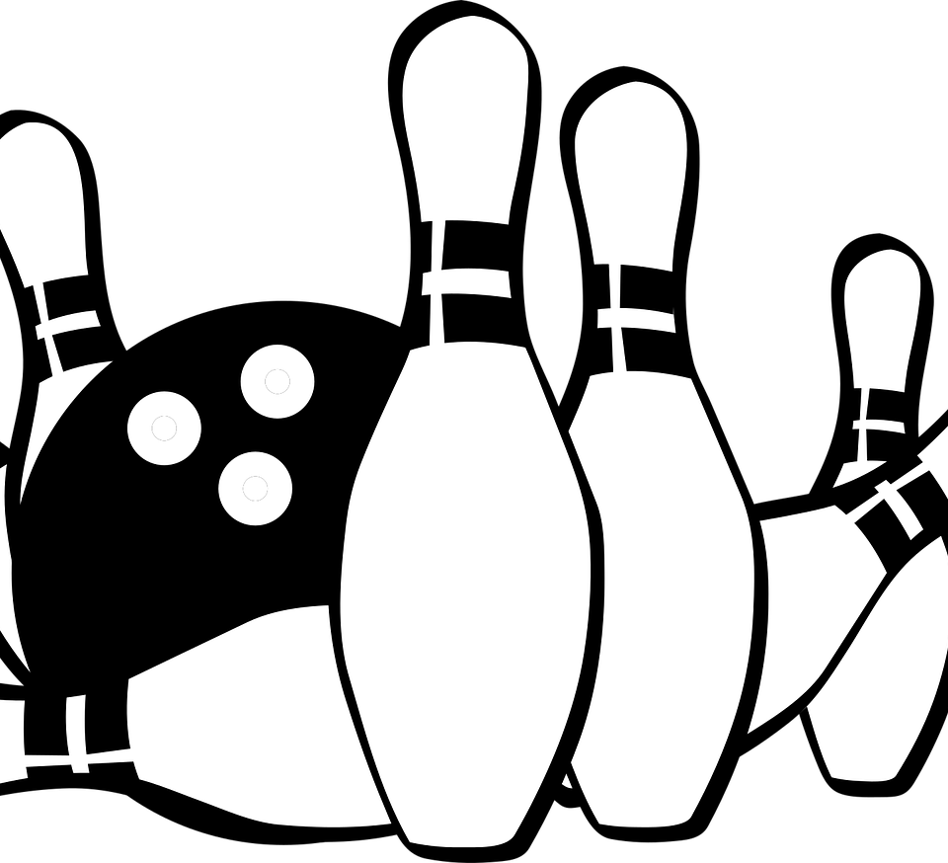

Booling
Instructions: Roll ball at ghost-decorated pins, try to beat score.

Slide 22
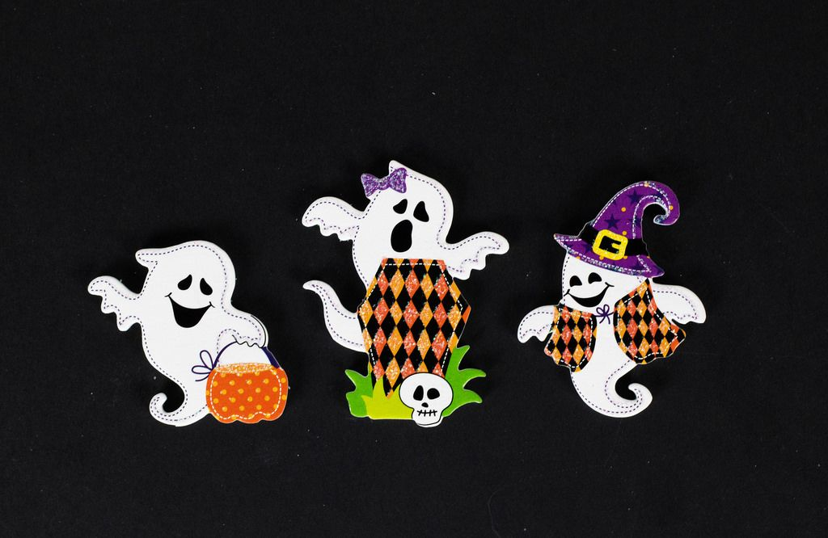

Float the Ghosts
Instructions: Volley ghost balloons, count hits before it falls.

Slide 23
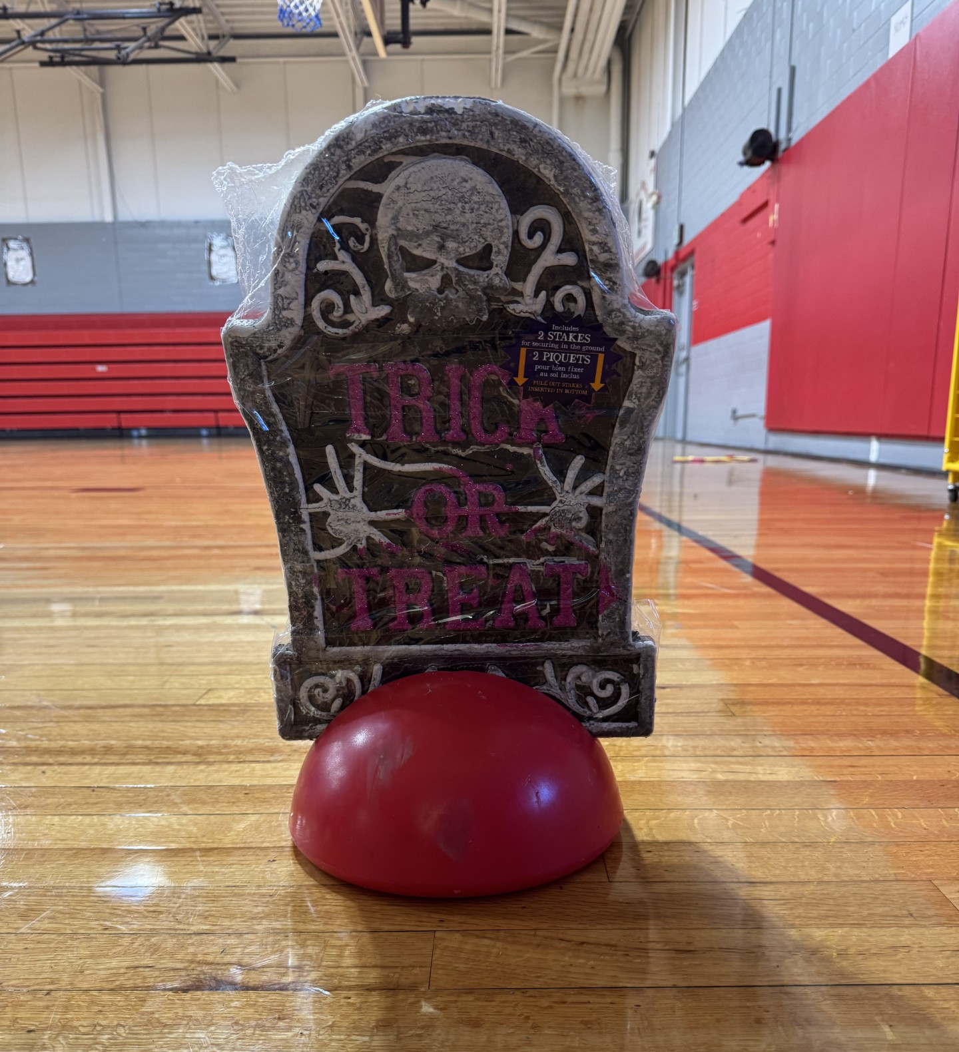
Hurdle the Headstones
Instructions: Jump/hop/leap over foam headstones, recall locomotor skill used.

Slide 24
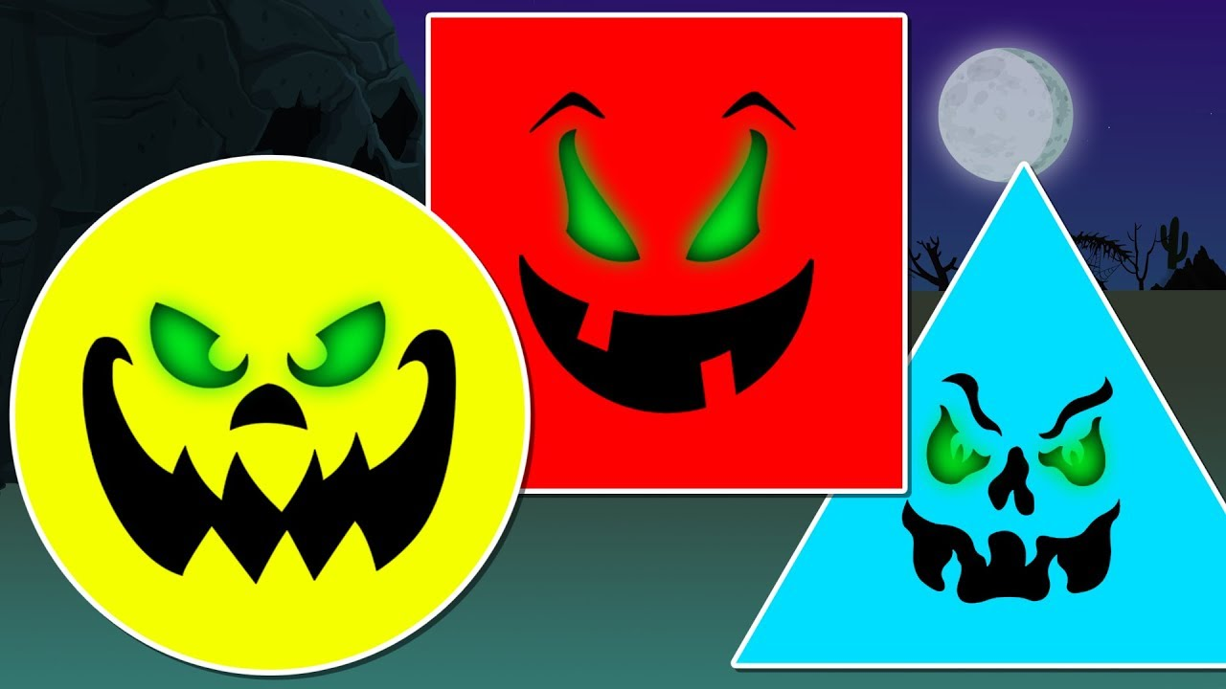
Pumpkin Patch Roll
Instructions: Roll on scooter between pumpkins with shapes, name shapes and recall which Halloween objects are those shapes.

Slide 25
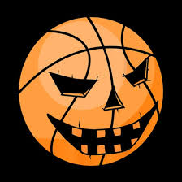
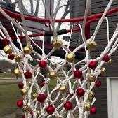
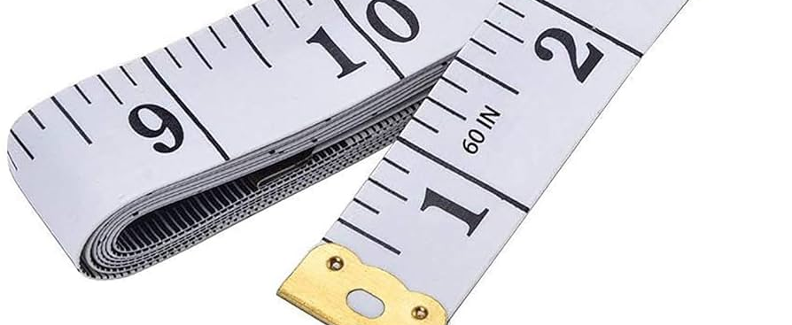
Ring the Doorbell
Instructions
Throw balls at goal with bells then recall distance and ball size

Slide 26
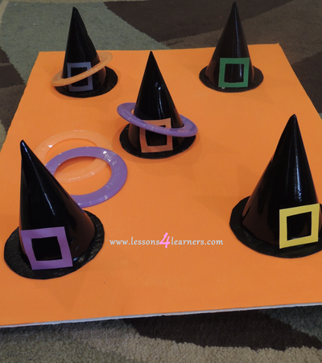
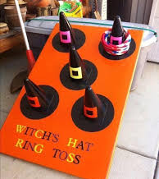
Witches Hat Ring Toss
Instructions: Toss hoops onto cones with witch hats, count successful tosses.

Slide 27

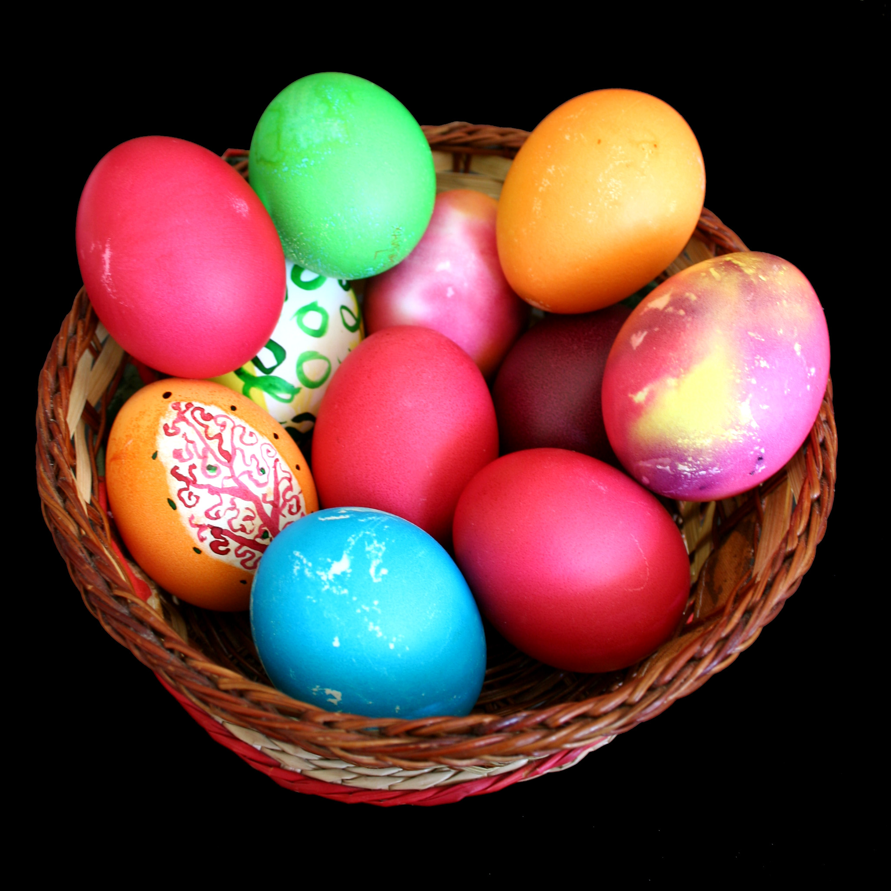
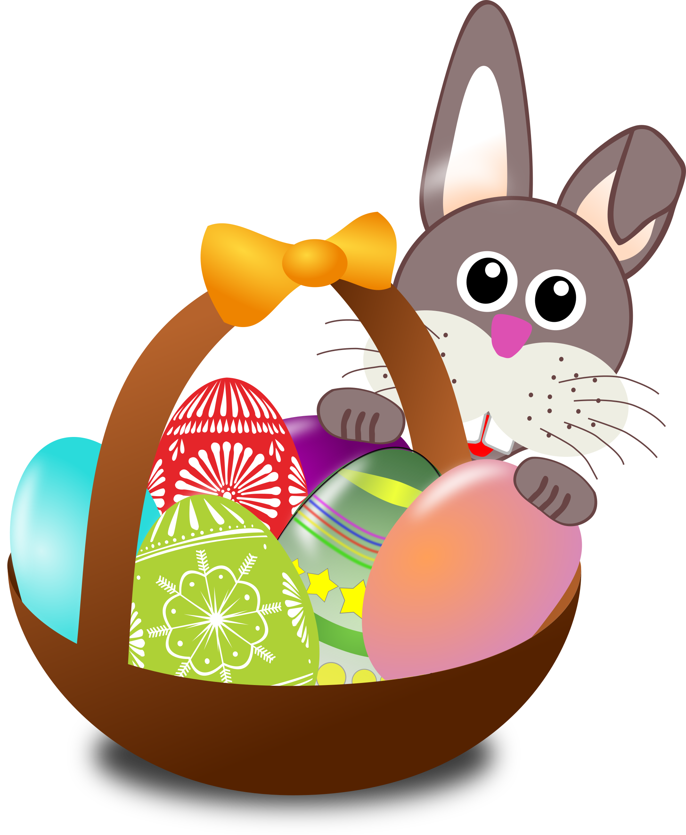
Easter Stations
Students rotate through nine fun and active holiday-theme stations.

Slide 28
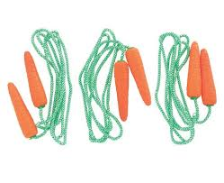
Carrot Jump Ropes
Activity: Self-turn a jump rope using proper form.
Materials: 4 carrot jump ropes (Dollar Tree)
Skills: Endurance, coordination

Slide 29
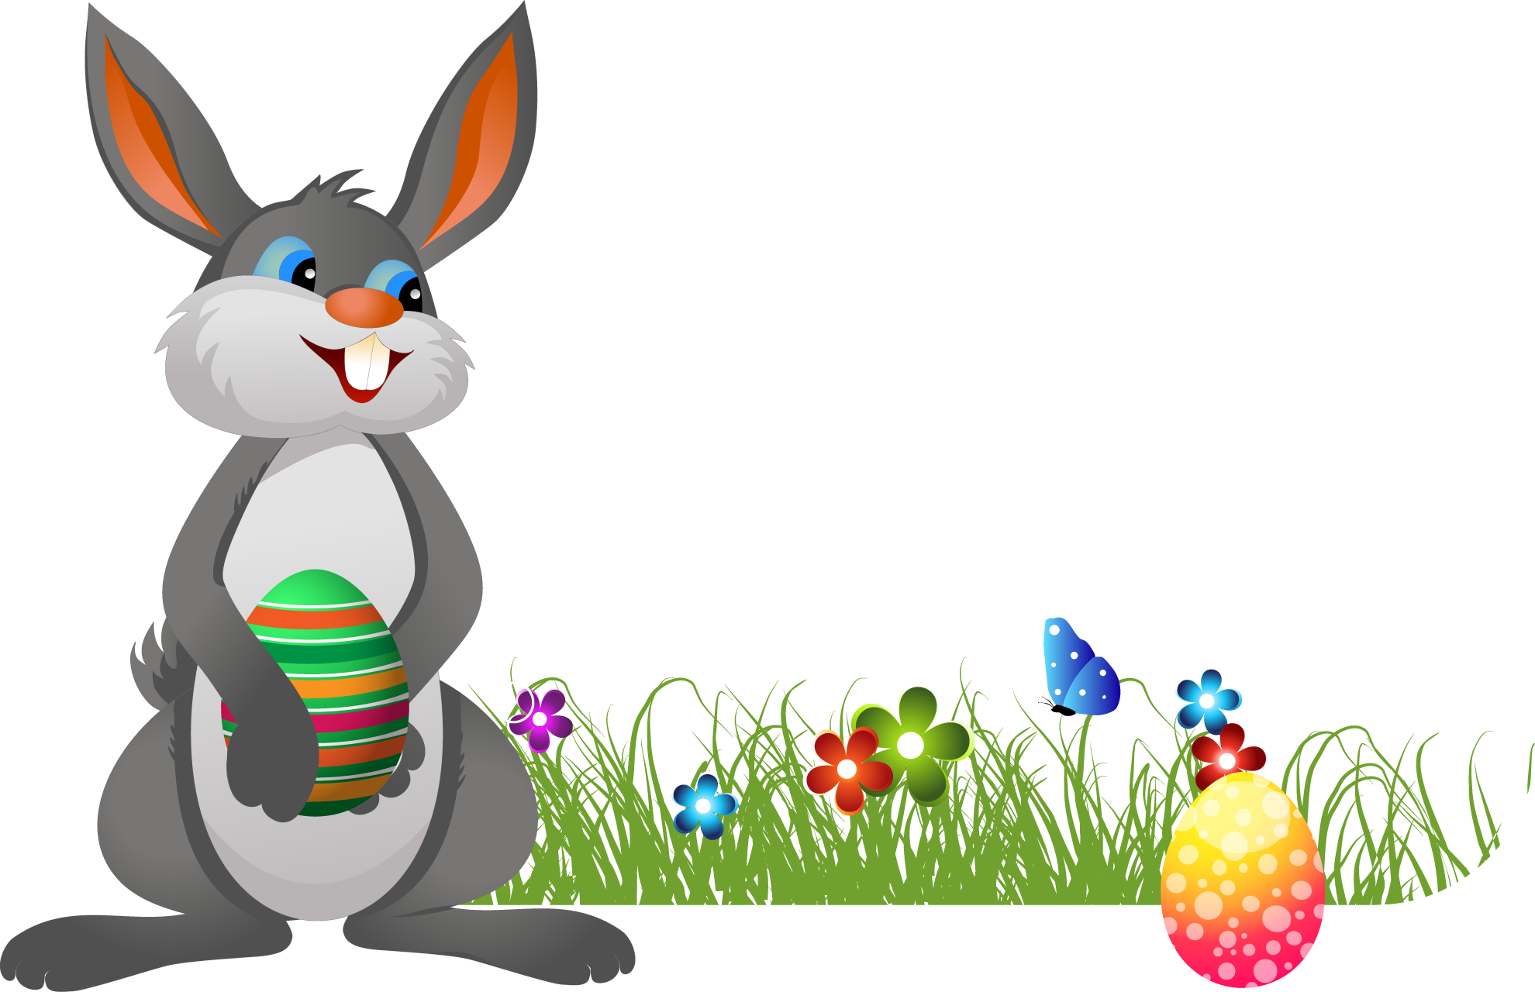
Egg Hunt
Activity: Search through baskets to find hidden Easter eggs
Rules: No dumping-dig and sort carefully
Materials: 2 white baskets, 2 Easter baskets, plastic eggs, various PE equipment (foam dice, bean bags, balls, rubber critters, batons)
Skills: Spatial awareness, patience, sorting

Slide 30

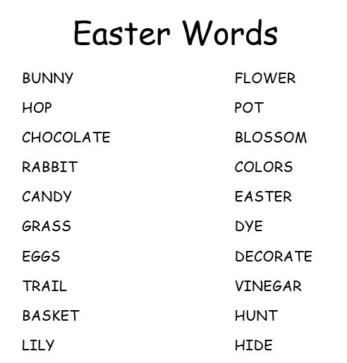
Spell Easter Words
Activity: Use letter cards to spell as many Easter-themed words as possible
Materials: Letter cards, Easter word poster
Skills: Spelling, reading , cooperation, teamwork

Slide 31
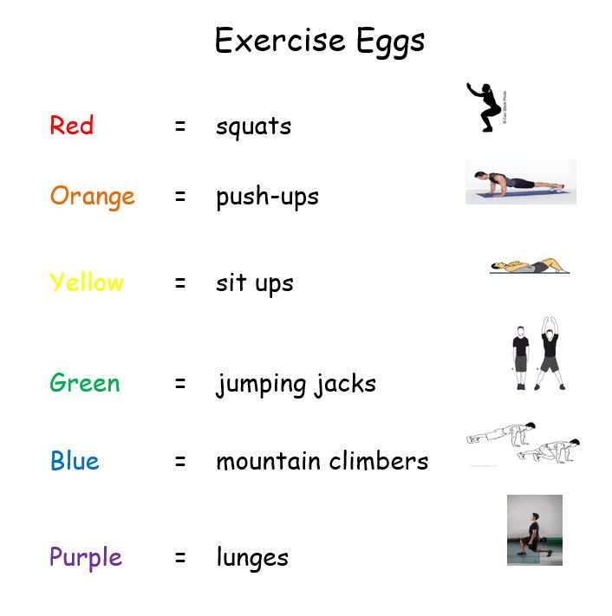
Exercise Eggs
Activity: Pick an egg, match the color strip to the exercise poster, and complete 10 reps
Materials: Plastic eggs, 2 baskets, color strips, exercise poster
Skills: Muscular strength, endurance, cardio

Slide 32

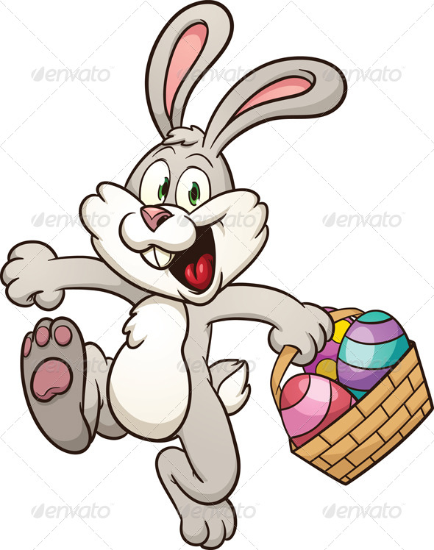
Hopping the Trail
Activity: Hop from spot to spot carrying an egg from one basket to another
Materials: Plastics eggs, 18 spots, 2 baskets
Skills: Muscular strength, coordination, hopping

Slide 33
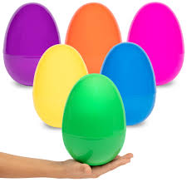
Egg Head
Activity: Balance a jumbo egg on a foam ring atop your head and walk a line
Materials: 4 foam rings, 4 jumbo eggs, 8 cones
Skills: Balancing, tempo

Slide 34
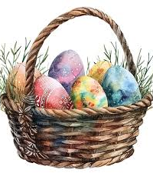
Tossing Eggs in a Basket
Activity: Toss taped plastic eggs into decorated crates or baskets
Materials: Plastic eggs, 2 decorated crates or baskets, 2 extra baskets for unused eggs
Skills: Hand-eye coordination, tossing

Slide 35
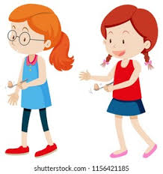
Egg Spoon Race
Activity: Balance a wooden egg on a spoon and walk a line
Materials: 4 wooden spoons, 4 wooden eggs, 8 cones
Skills: Balancing, tempo

Slide 36
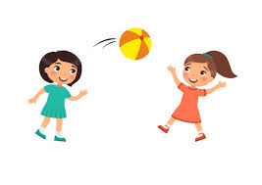
Partner Egg Toss
Activity: Toss a jumbo egg back and forth with a partner, stepping back every 5 successful passes
Materials: 4 jumbo eggs
Skills: Hand-eye coordination, catching, tossing, cooperation

