Slide 1
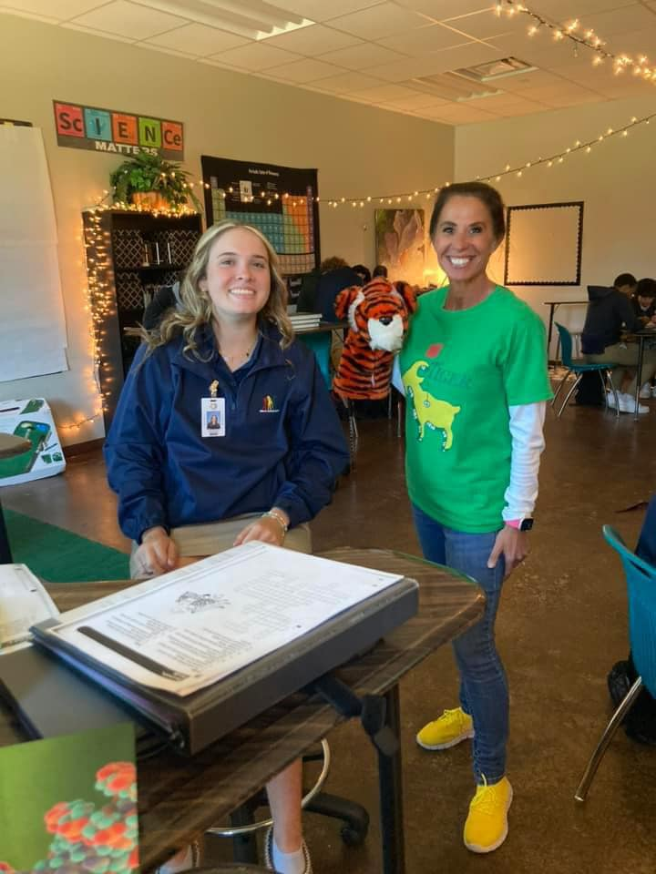
Biology LEAP Standards and PE classes
Jamie Tanner

Slide 2
“What happens when you put a science classroom teacher in PE?
Your students CAN DO what you teach them. No matter how challenging. Engage them. When students WANT to learn,
THEY WILL.
1st graders CAN identify and place 20 bones.
Scootin' Skeletons

Slide 3
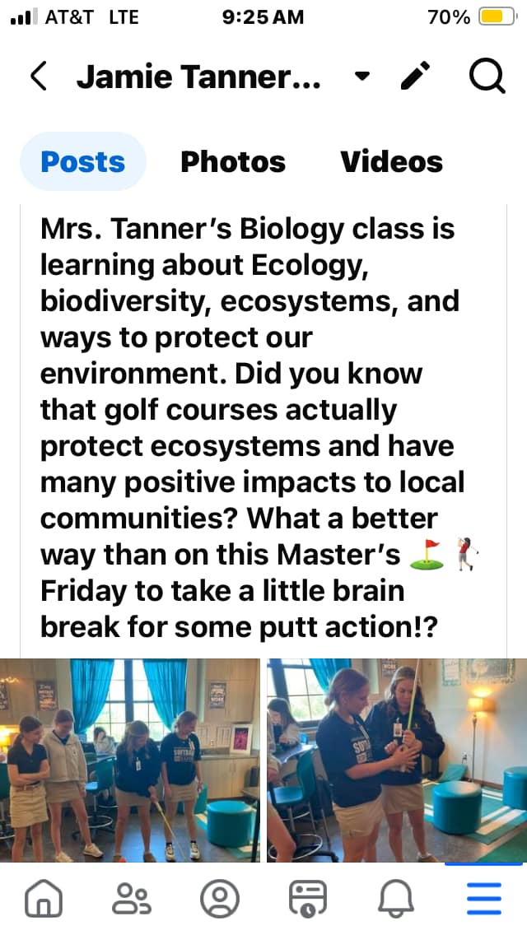
Be THAT teacher who the school is constantly posting on social media how fun it is to be in your class!

Slide 4
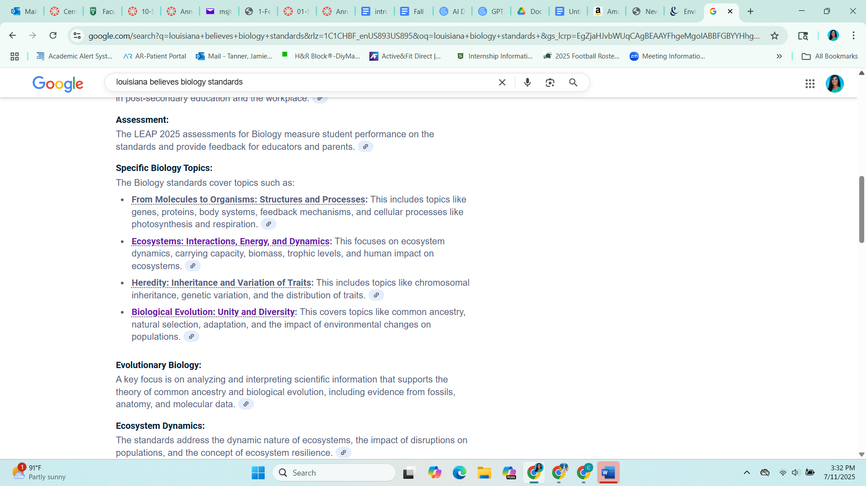

LDOE Biology

Slide 5
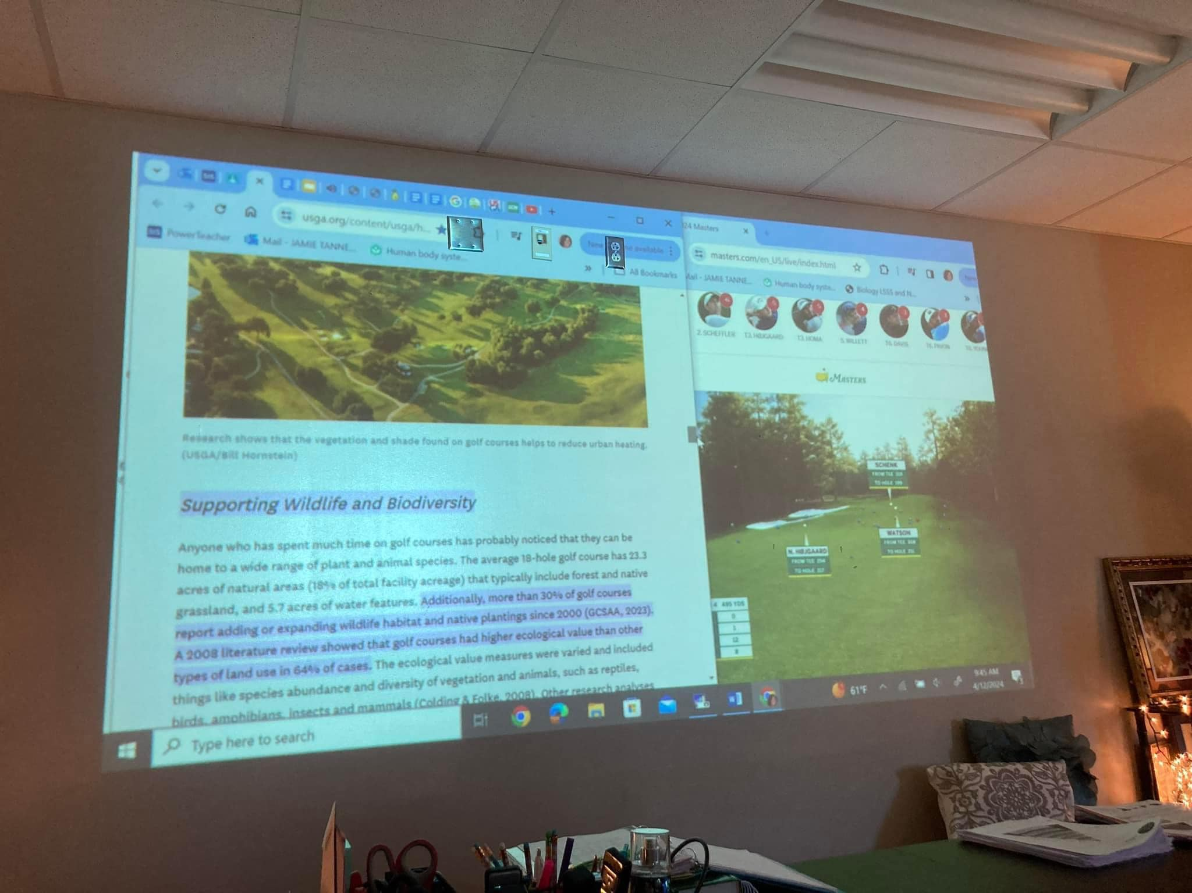
WHS Biology
https://www.facebook.com/share/1CcEDYy956/?

Slide 6
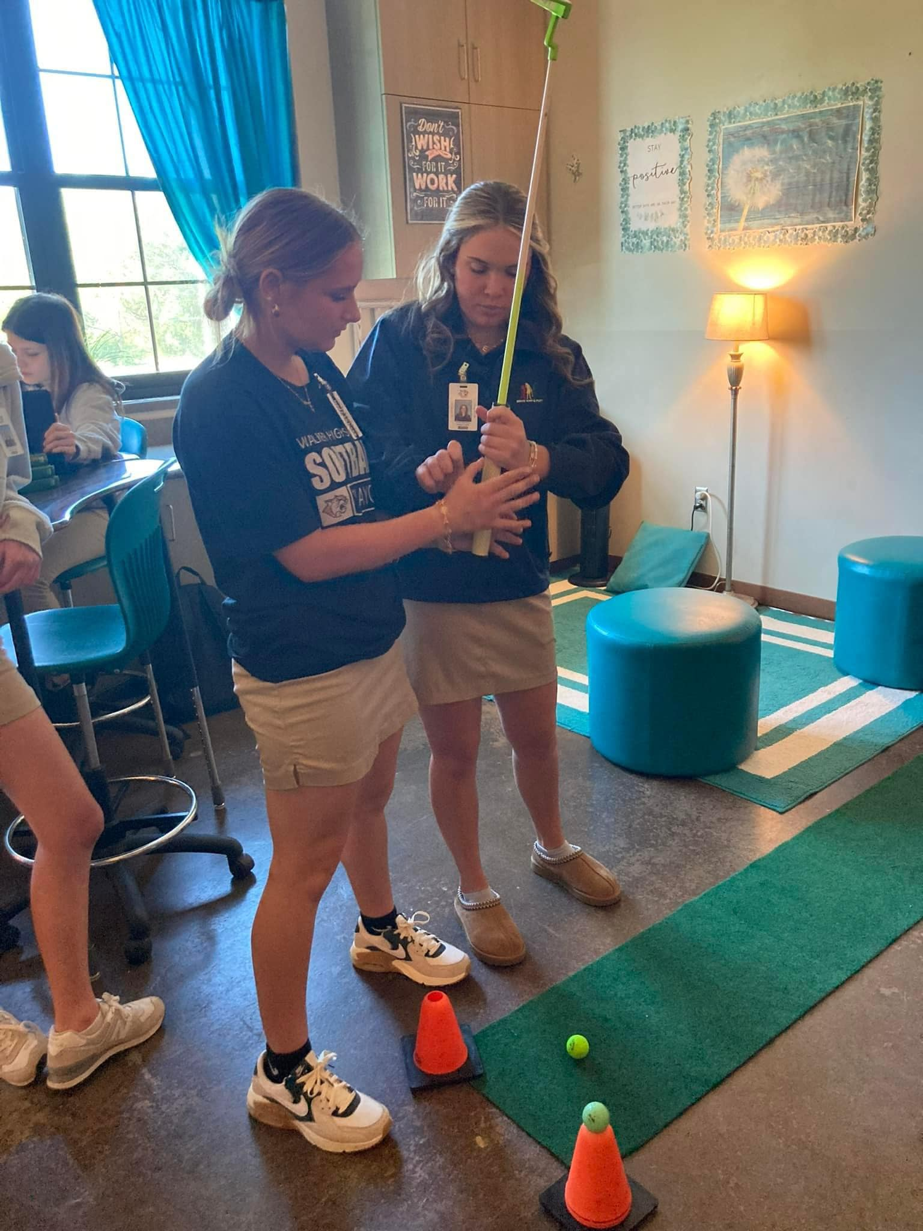
Get your school’s golf team/future LPGA stars, to be guest teachers.
Aka- STUDENT LED while I am working with content in small groups.
WHS Biology
https://www.facebook.com/share/1CcEDYy956/?

Slide 7
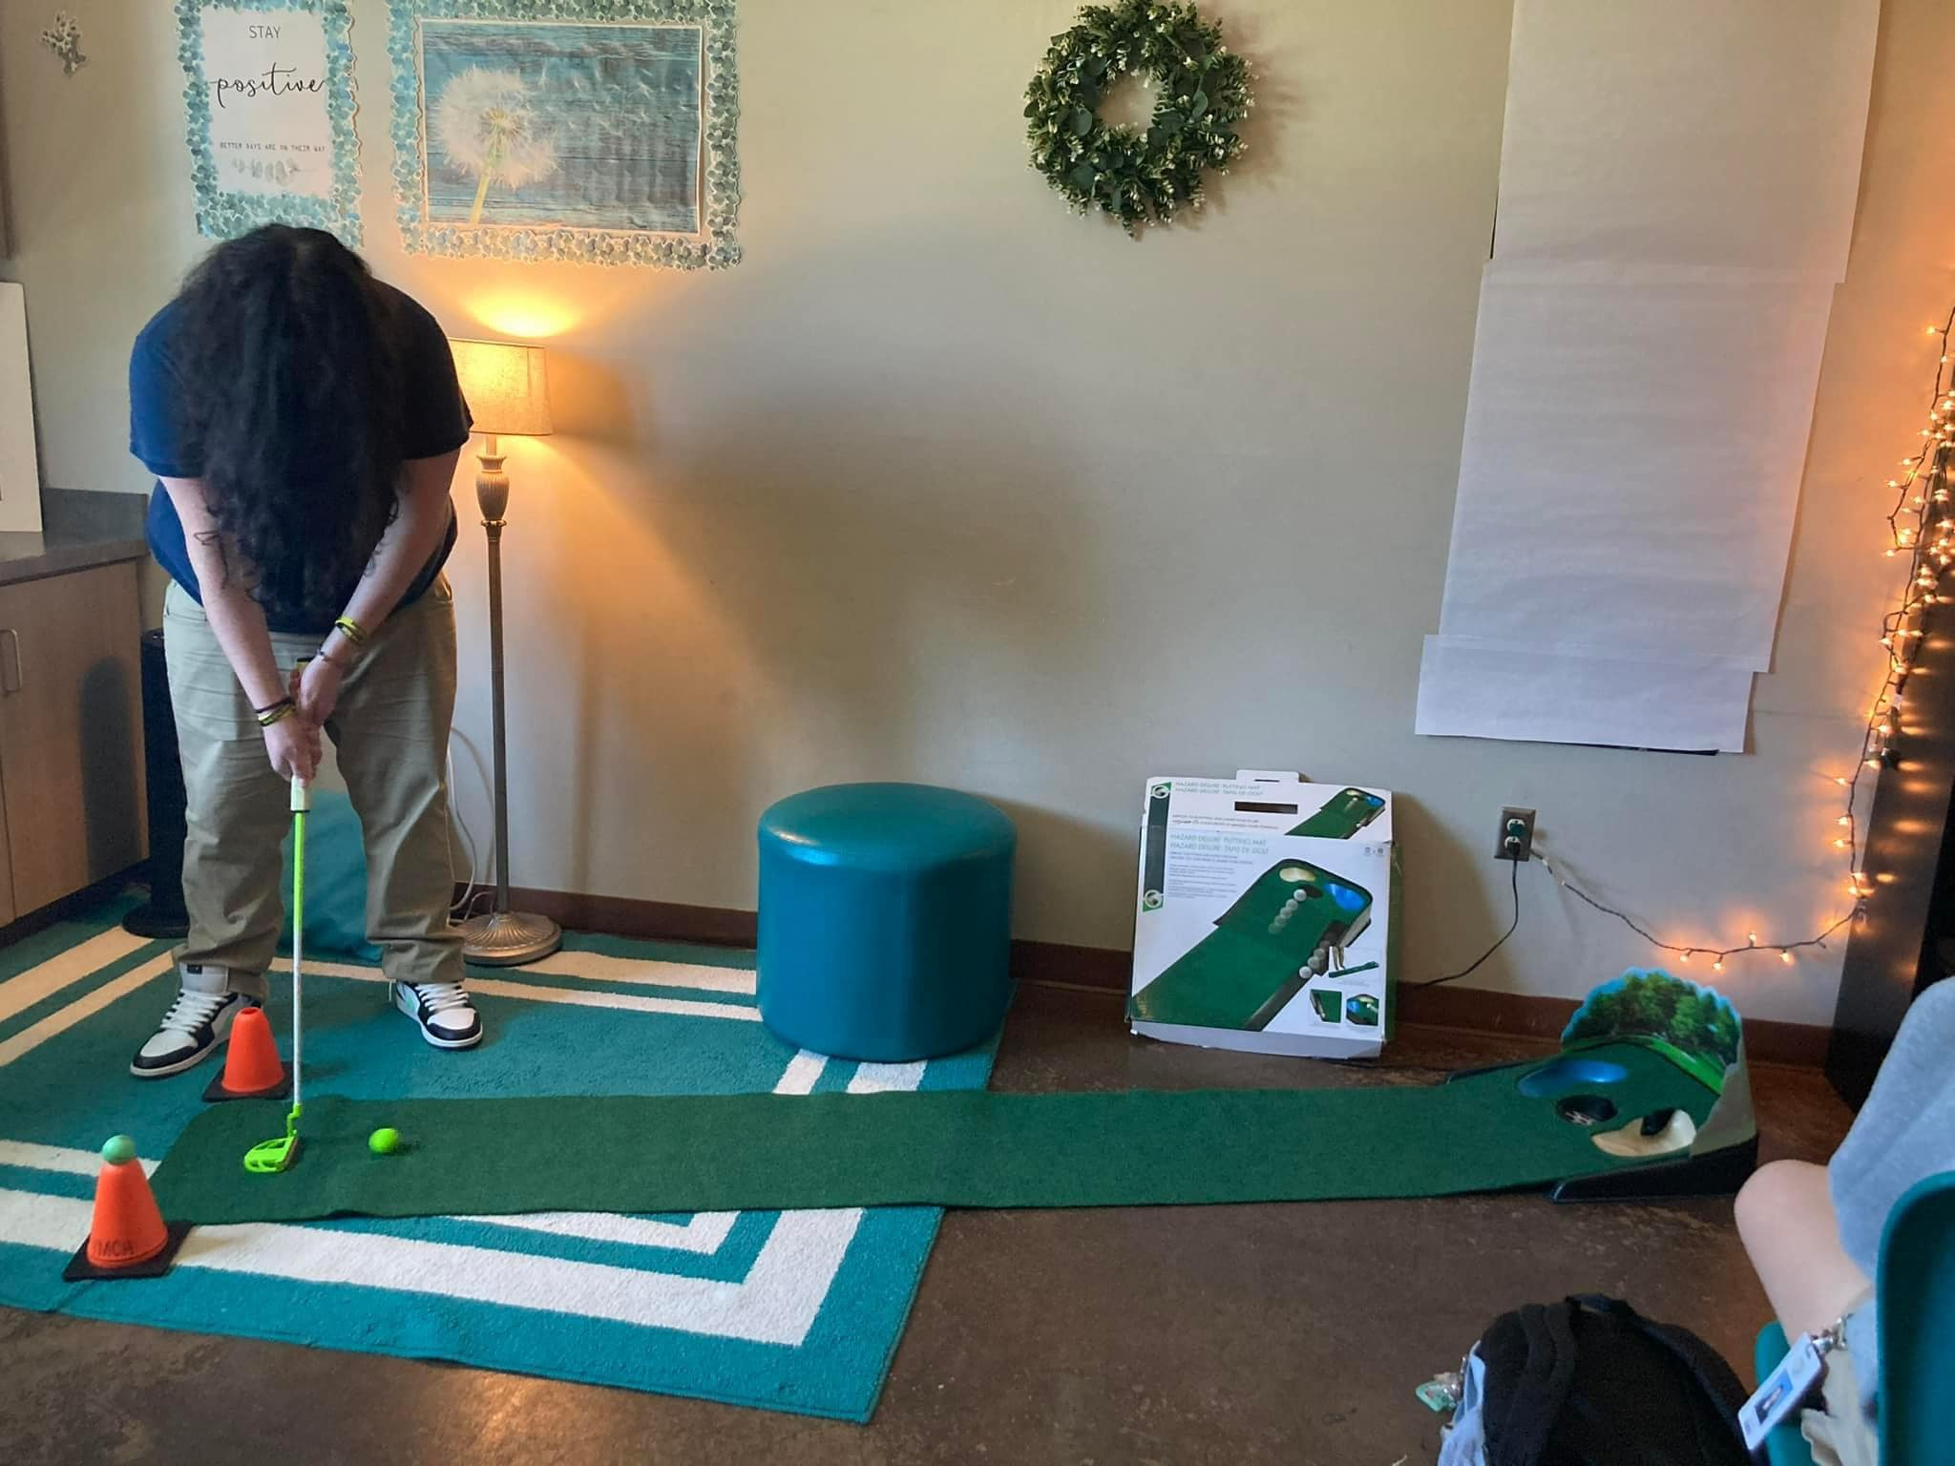
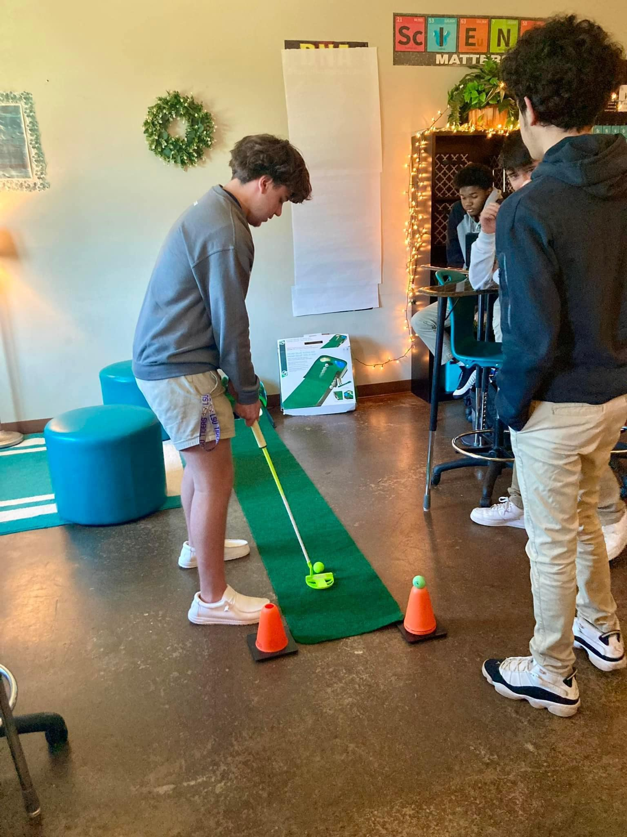
Students who are difficult to engage, actually make like to get out of their desk and go for a putt”
LDOE Biology

Slide 8
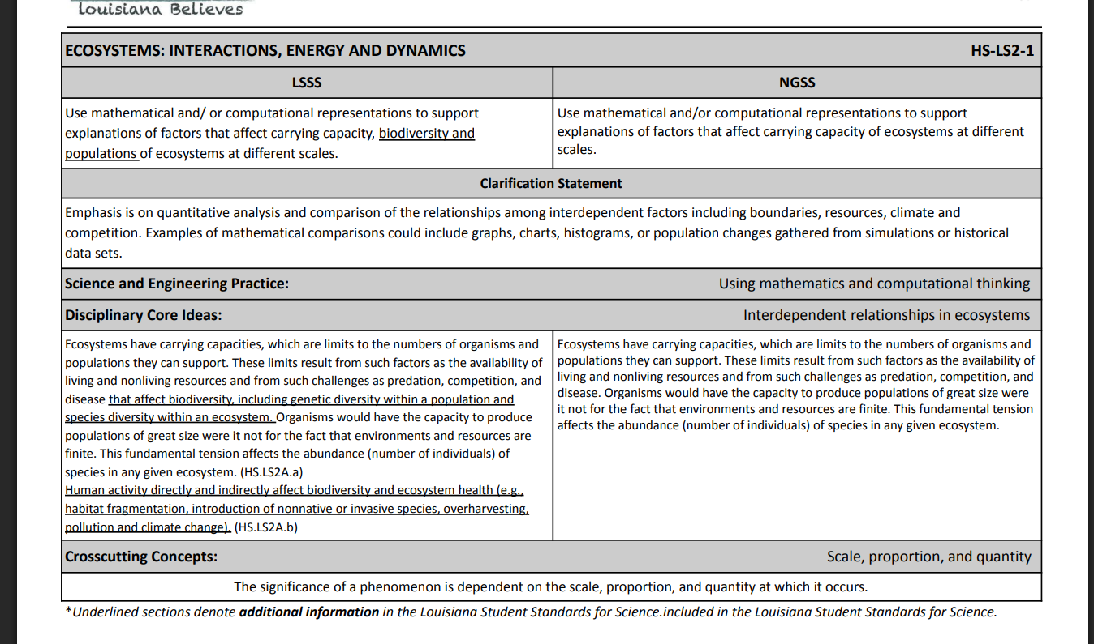

Slide 9
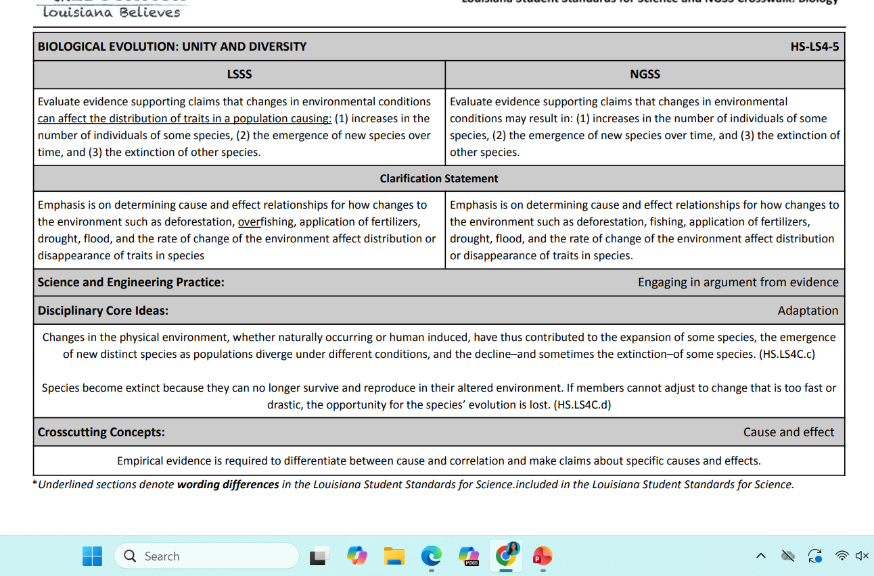

Slide 10
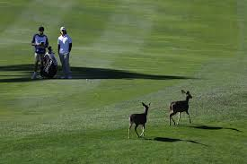
https://www.randa.org/en/sustainability/environmental-benefits
https://www.randa.org/en/sustainability/environmental-benefits
Environmental Benefits of Golf
randa.org/en/sustainability/environmental-benefits

Slide 11
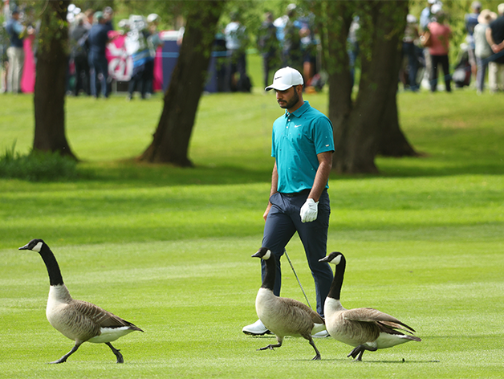
Golf Environment
Did You Know?
We have a long-established relationship with the conservation charity, the RSPB, who partner with us to improve the habitat management and wildlife value of golf courses and support golf in promoting its good work to the environmental lobby and government.
We are able to work with a dedicated Wildlife Support Advisor passionate around conserving wildlife and habitats of golf courses.

Slide 12
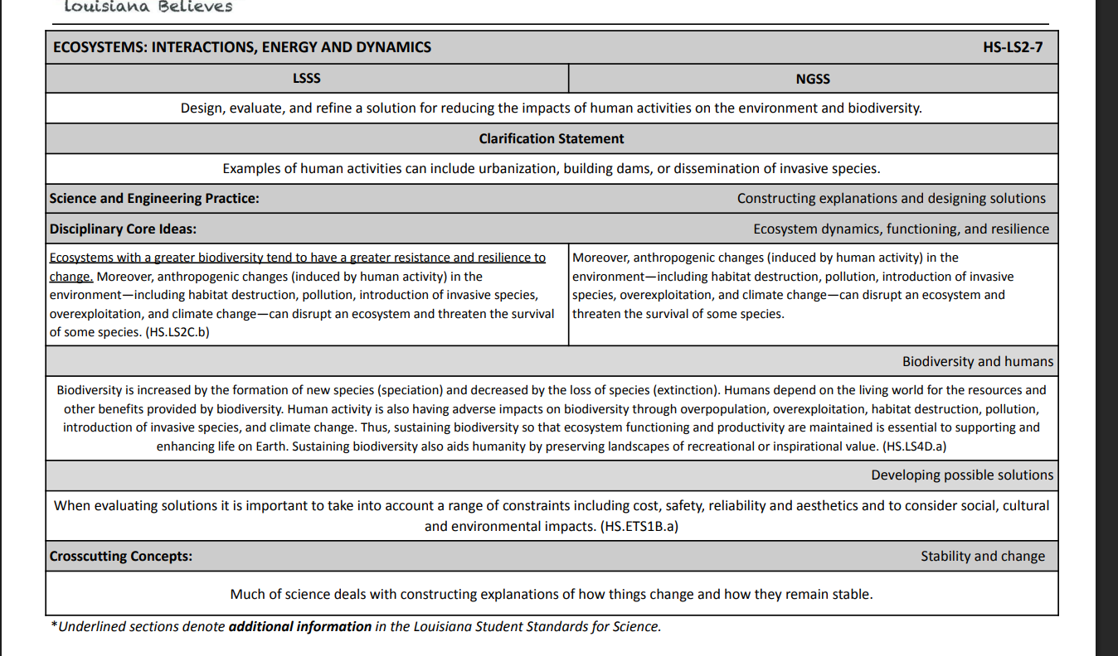
Golf Environment

Slide 13
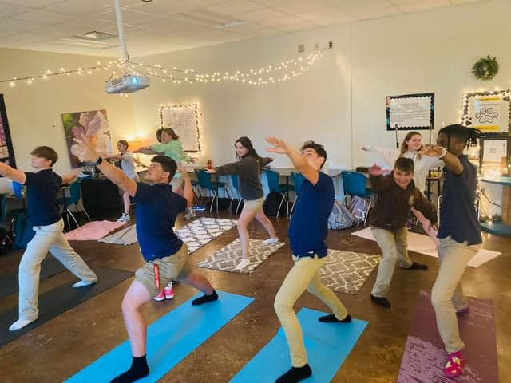
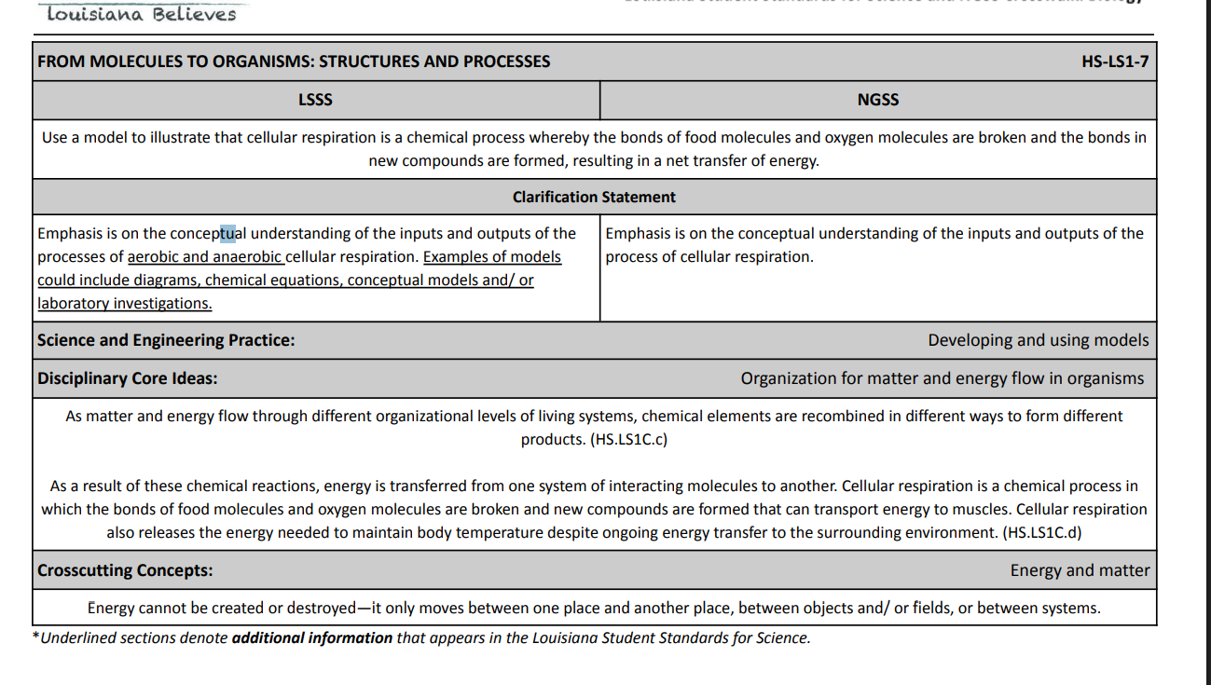
How does exercise and Yoga connect in Biology?

Slide 14
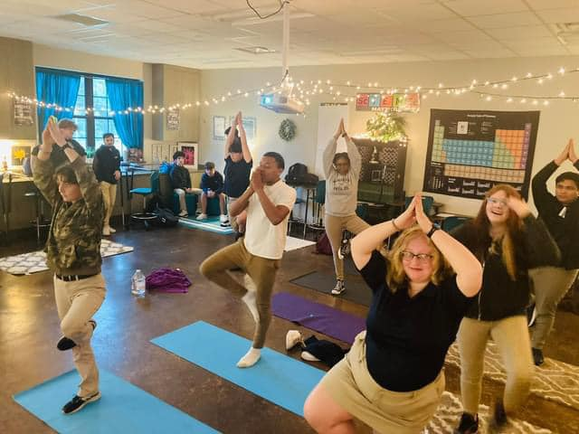
How does exercise and Yoga connect in Biology? These are regular paced students who scored higher than the “honors” class…

Slide 15
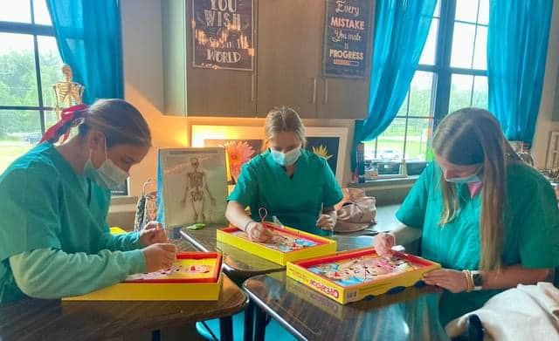

Slide 16
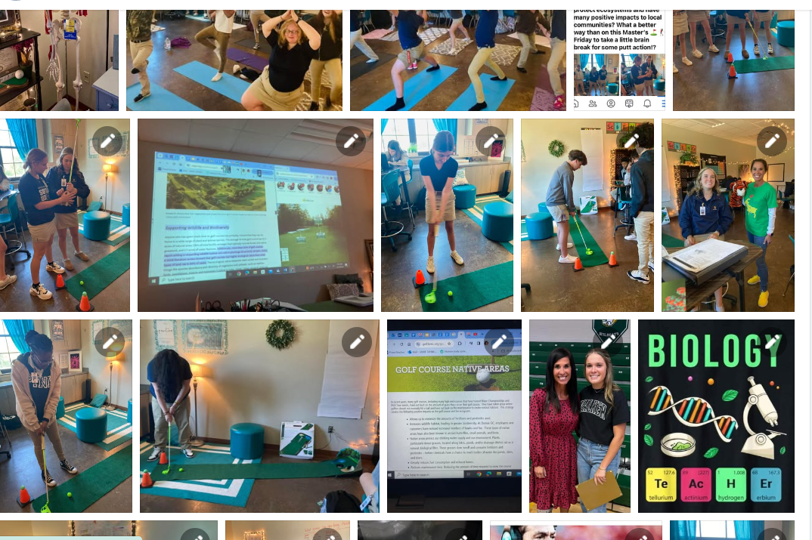
Let’s get up and play!

Slide 17
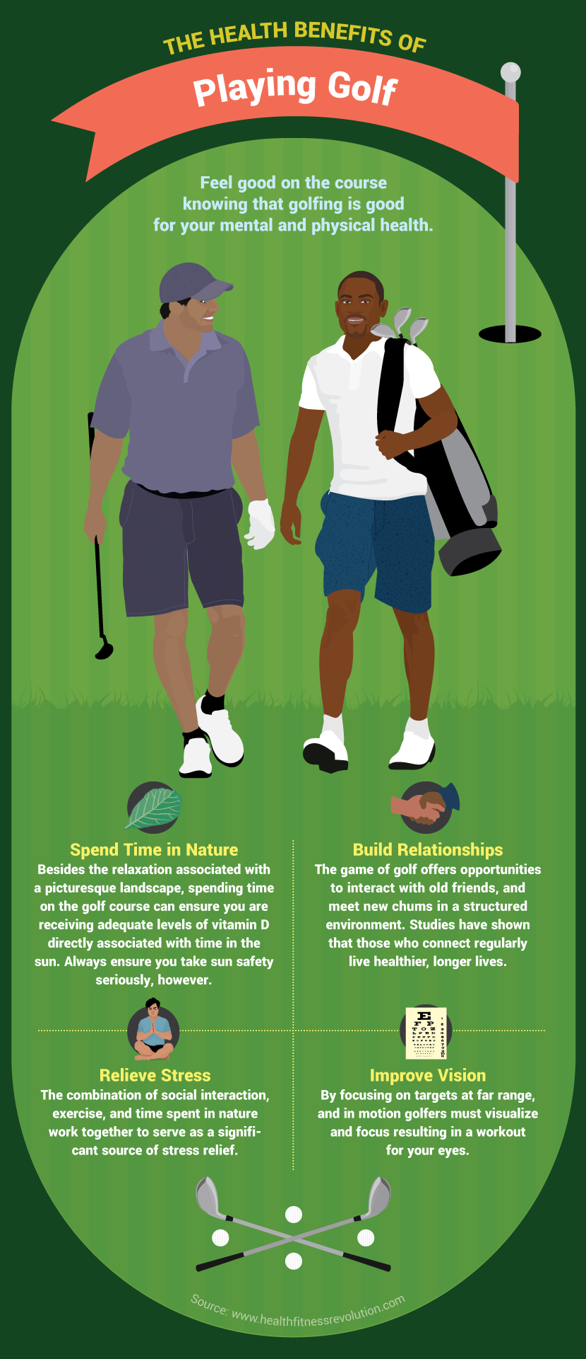
Mental and Physical Benefits of Golf
Let’s get up and play!

